Slide 1
An NSS Audio-Visual
Library Presentation
A Wet Dream: Exploration of Honey Creek Cave, 1989
George Veni, April 1989
S742 82 Slides 2/11/2021

Slide 2
Notes:
The exploration of Honey Creek Cave was the type of wet fantasy most cavers only dream about.

Slide 3
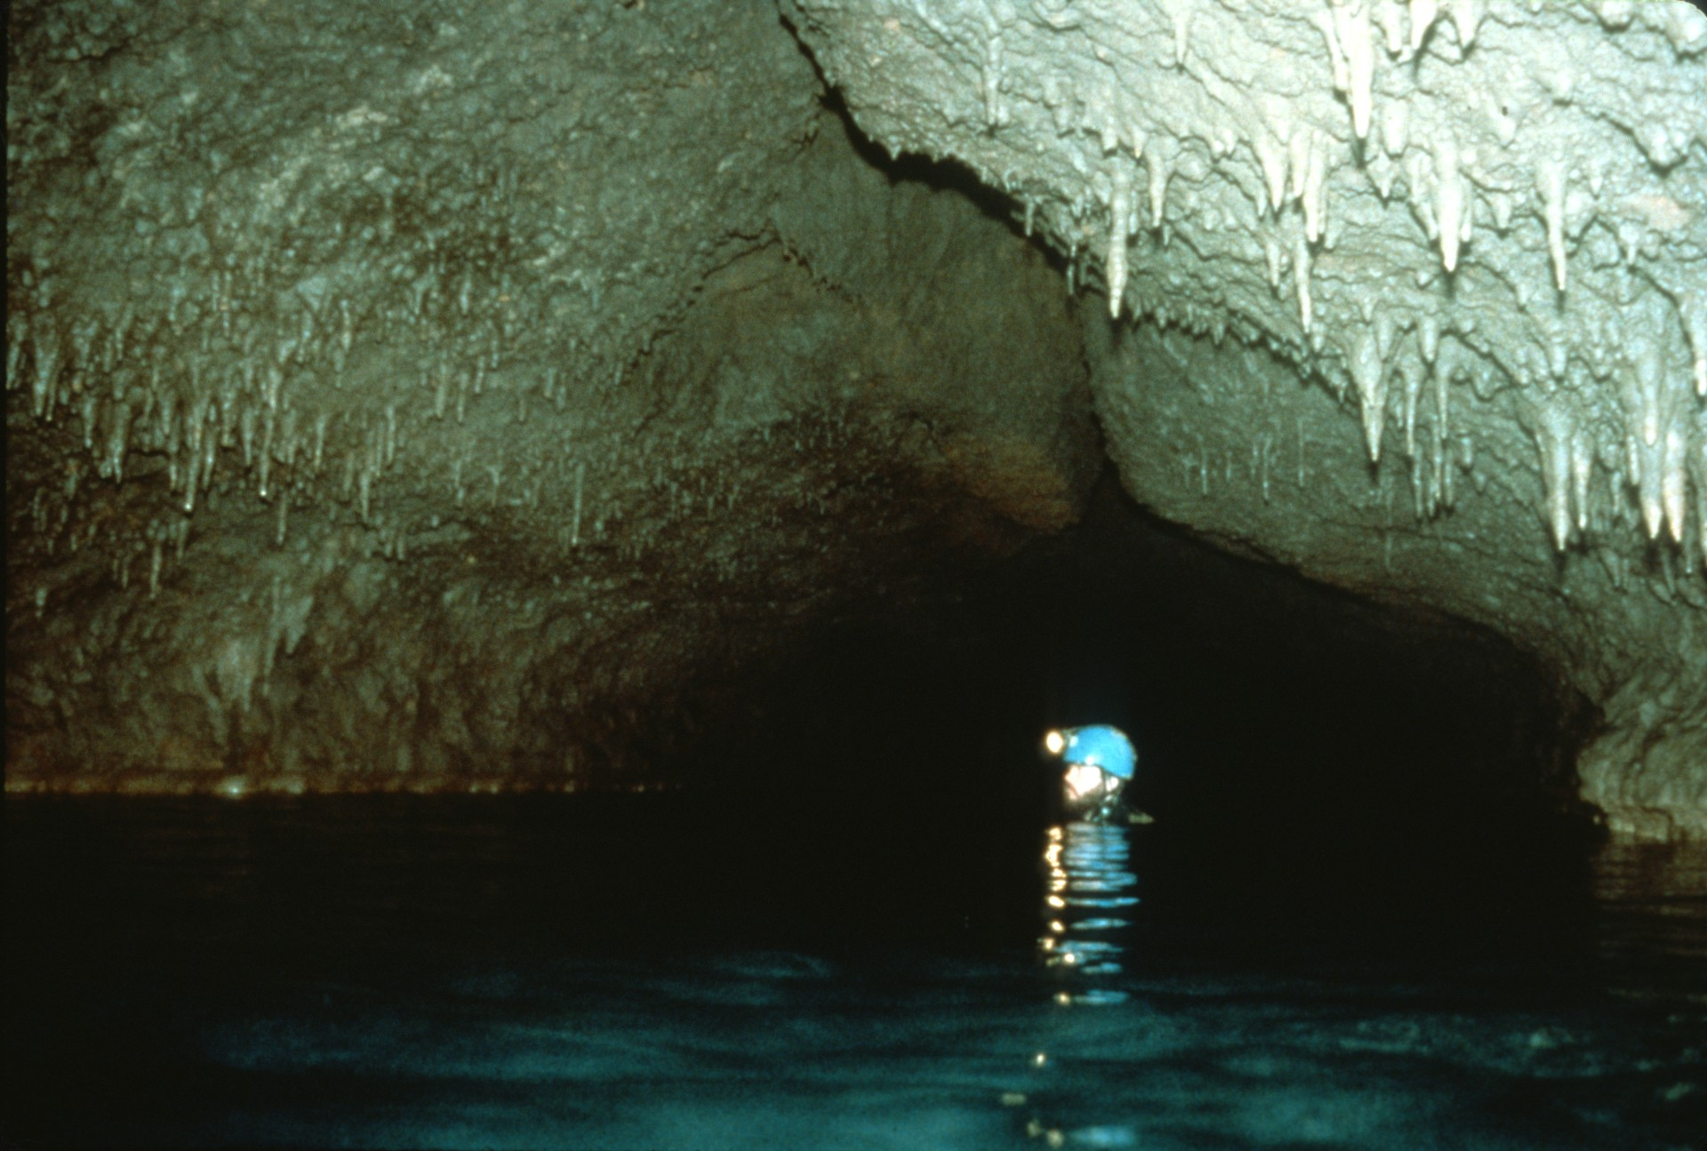
Notes:
From the beginning of the Honey Creek Project in July of 1980 until the end of 1988 more than 28 kilometers (18 miles) of wet passage had been mapped. By early 1989 it was the longest cave in Texas, the 20th longest in the USA, and the 50th longest cave in the world.

Slide 4
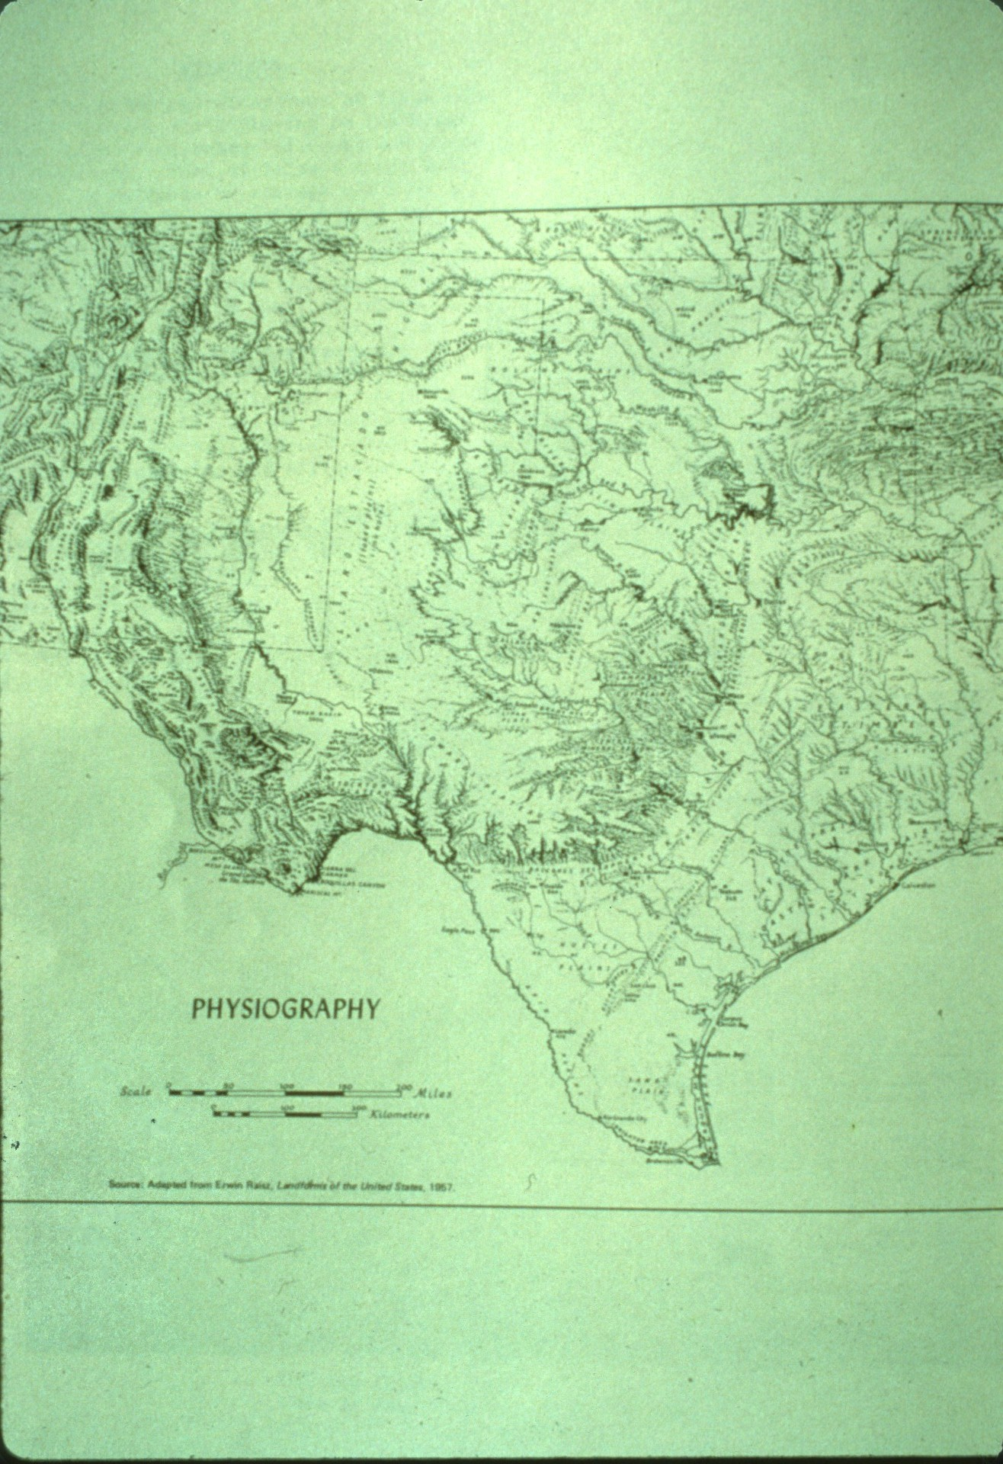
Notes:
Honey Creek Cave is centrally located in Texas in the southeastern corner of the Edwards Plateau.

Slide 5
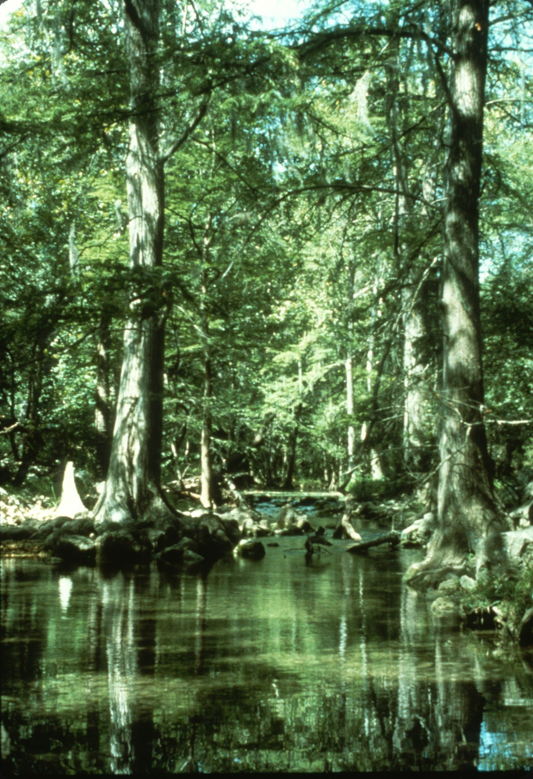
Notes:
Texas is a dry state and most of its streams flow only after a storm. One of the exceptions to that rule is Honey Creek.

Slide 6
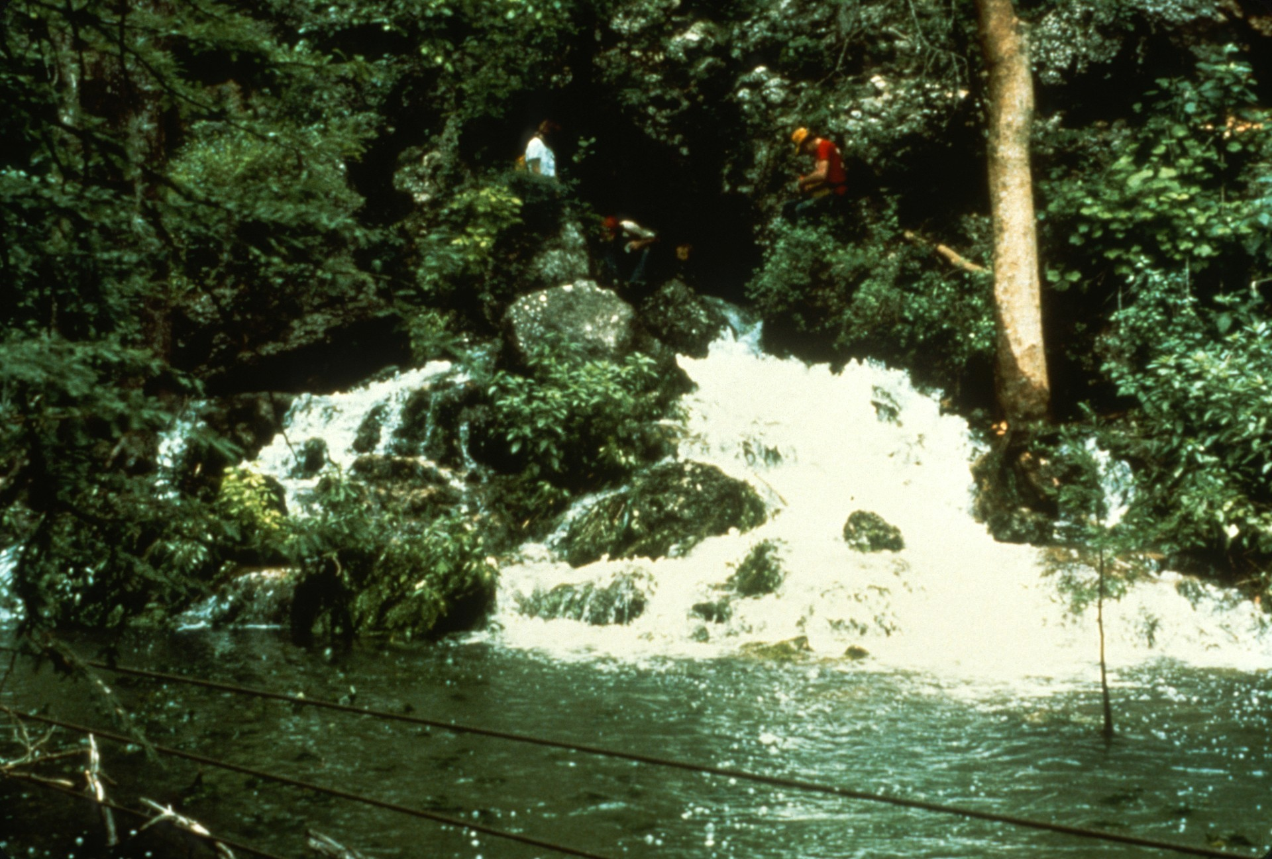
Notes:
The source of the water in Honey Creek is the large spring known as Honey Creek Cave.

Slide 7
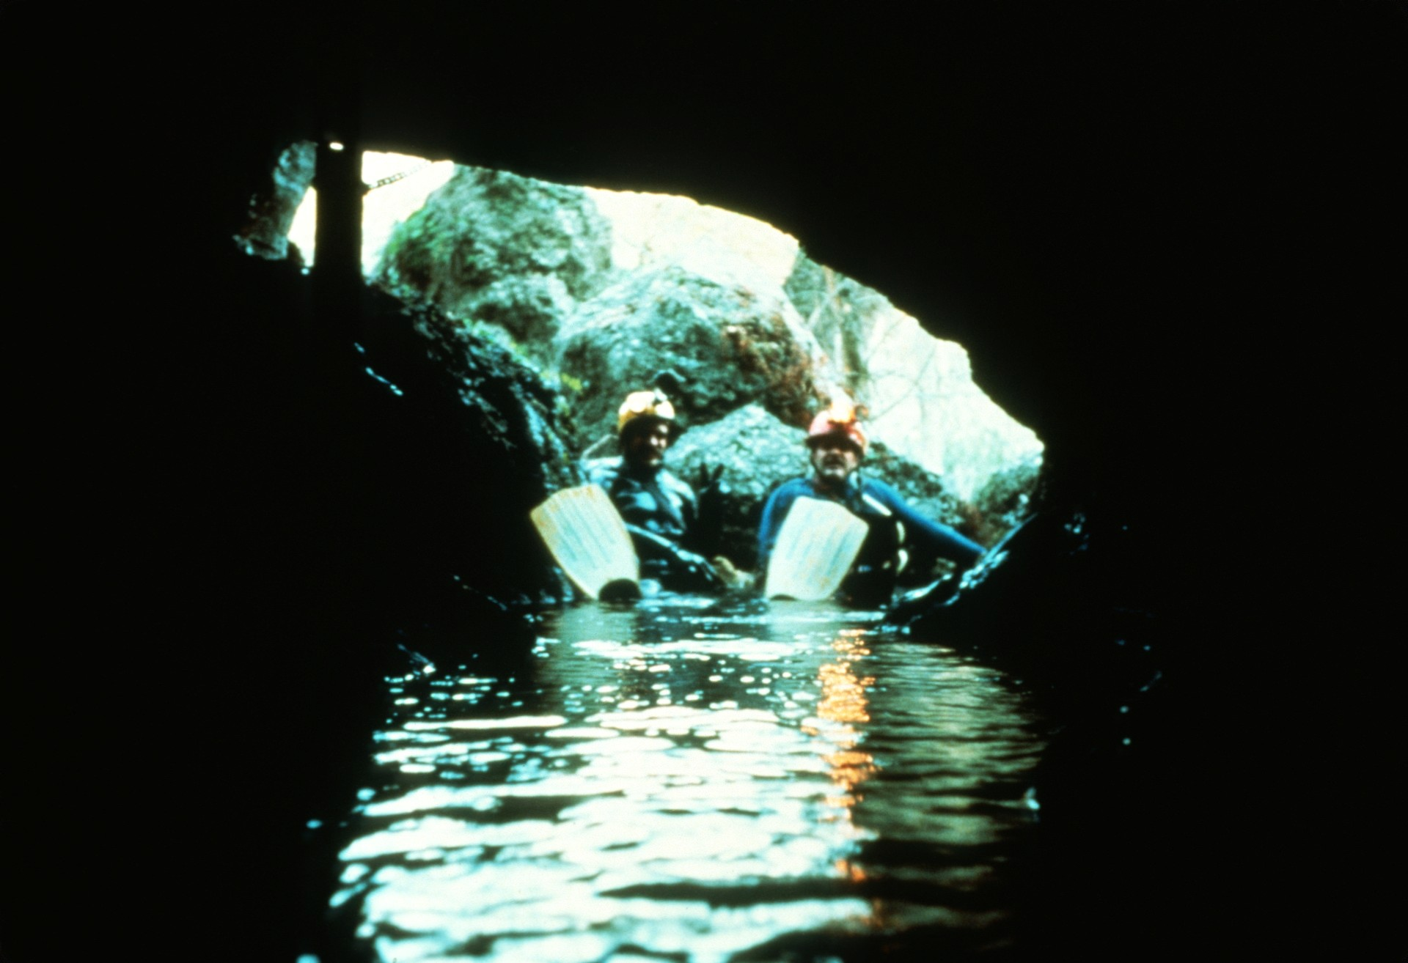
Notes:
Honey Creek Cave has two natural entrances. This spring or ''wet" entrance begins as a stoop-way but soon deepens and forces cavers to swim if they wish to explore any further.

Slide 8
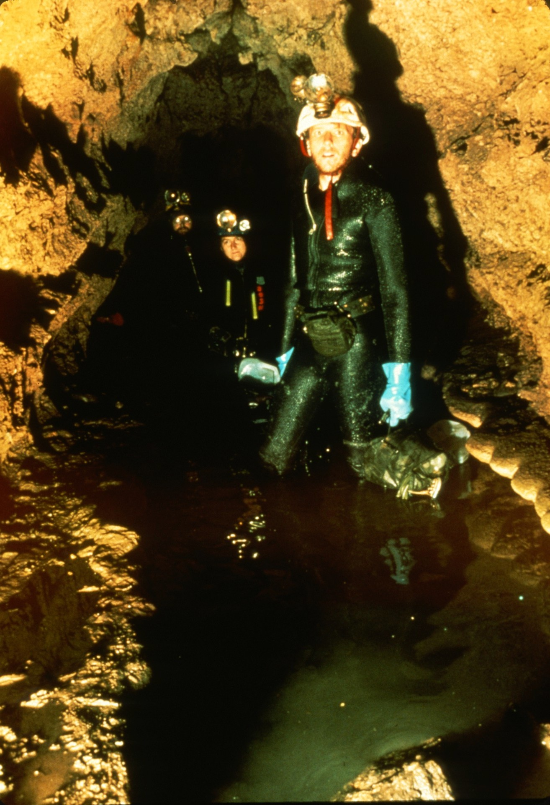
Notes:
Thirty meters away from the wet entrance is the dry entrance. This walking passage leads 20m to water, then around the corner...

Slide 9
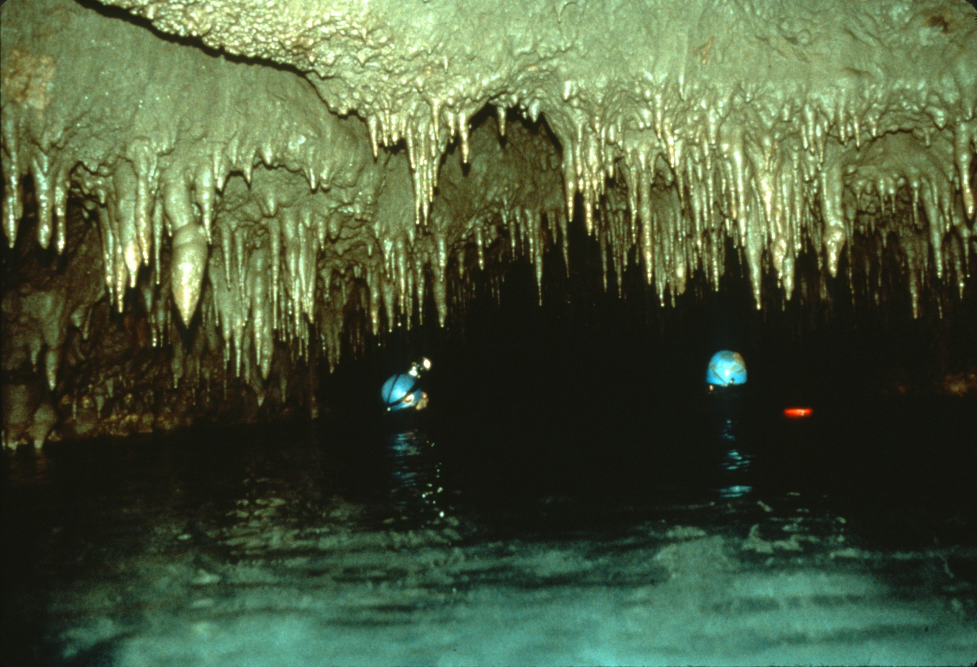
Notes:
…to drop into the main swim of Honey Creek. Behind us the cave goes to the wet entrance and ahead the cave just goes and goes.

Slide 10
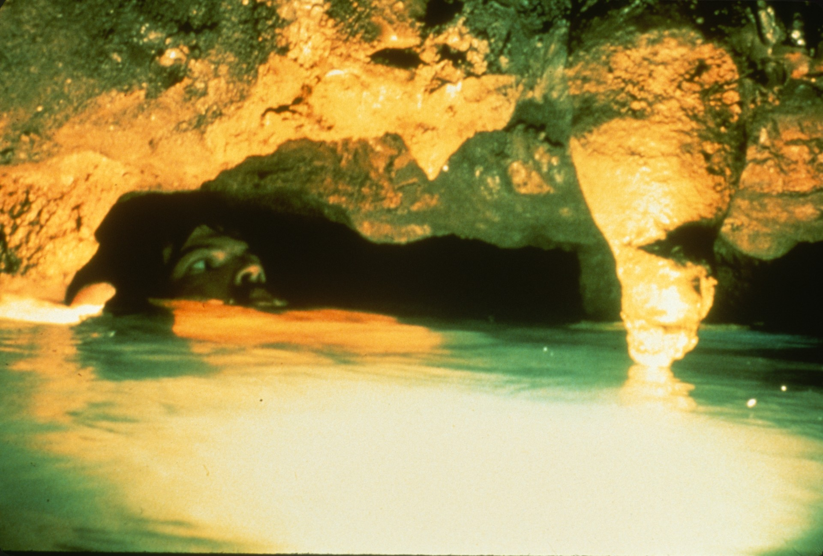
Notes:
The first barrier to the casual explorer is found 115 meters into the cave. The limited air space at "Whistler's Mother" has discouraged many people from further exploration, but many cavers have been enticed ahead by the abundant air flow.

Slide 11
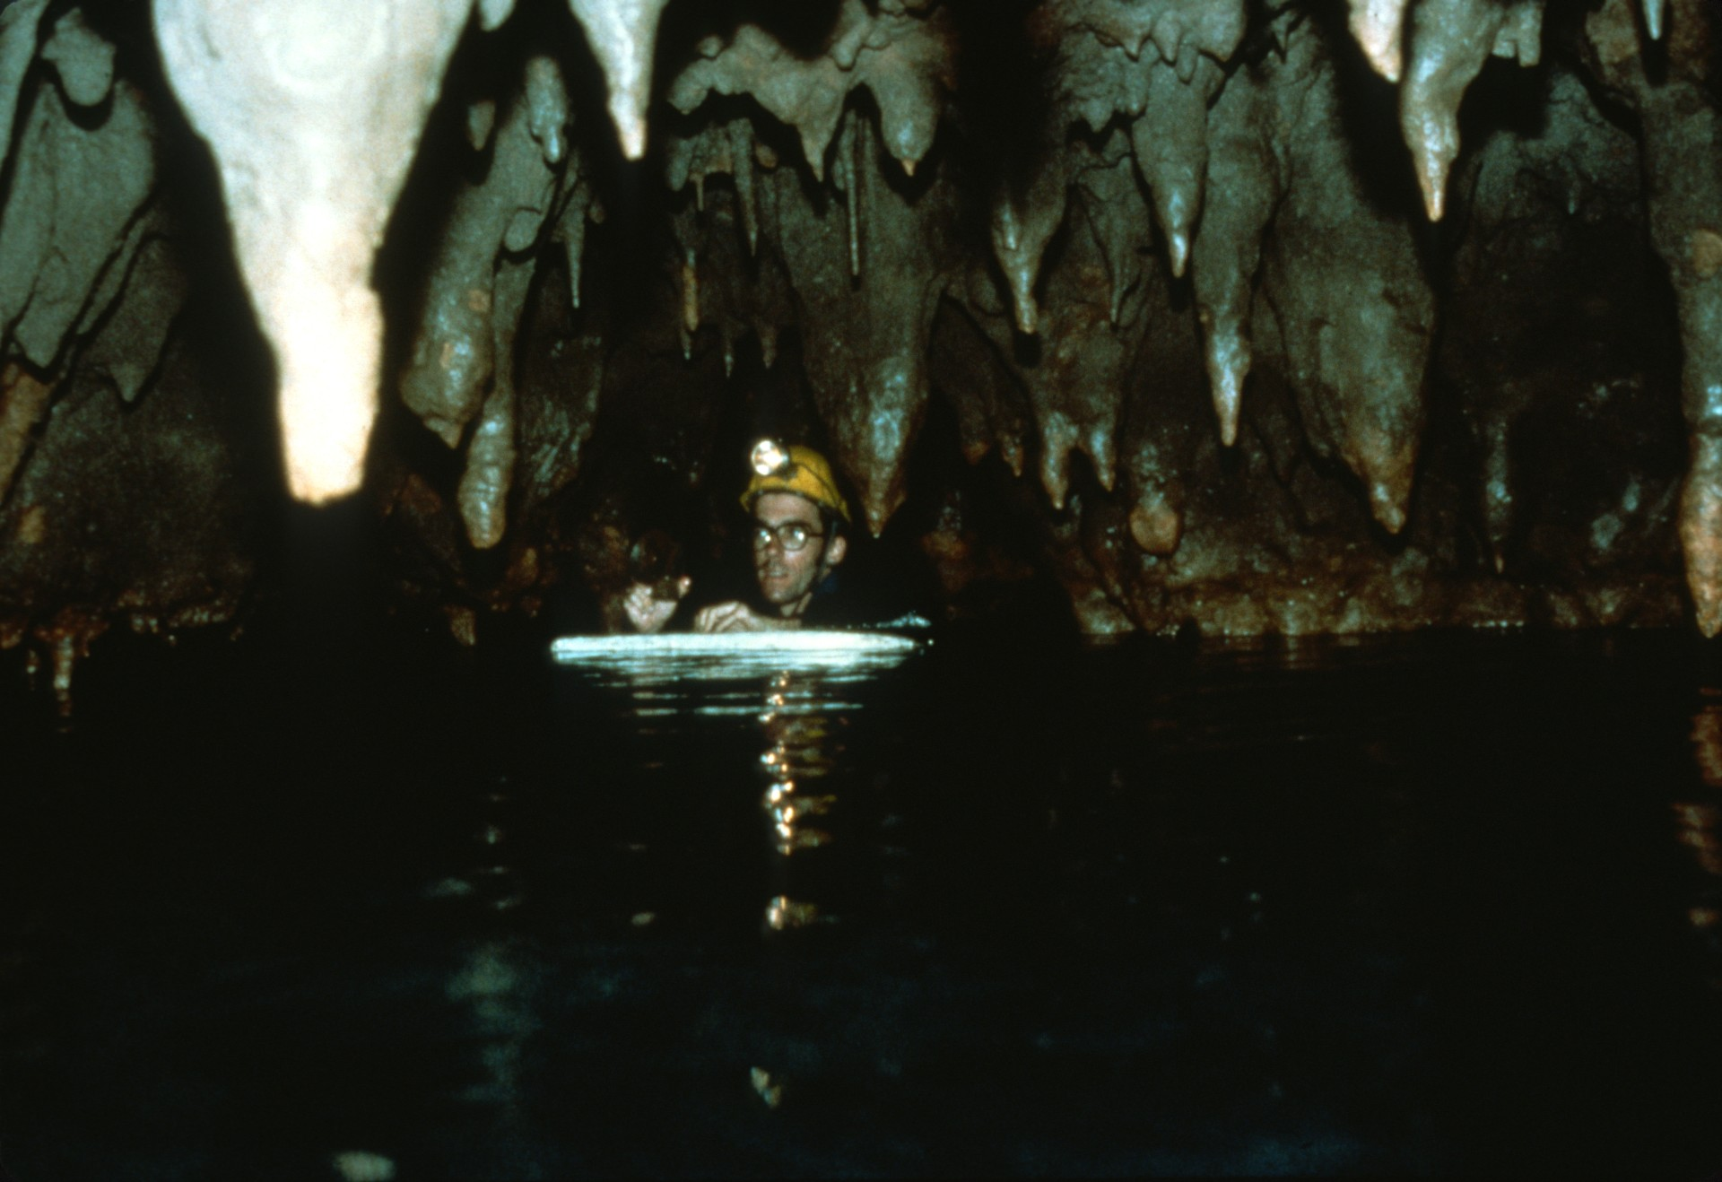
Notes:
Once on the other side of Whistler's, the cave continues, blue and beautiful as before.

Slide 12
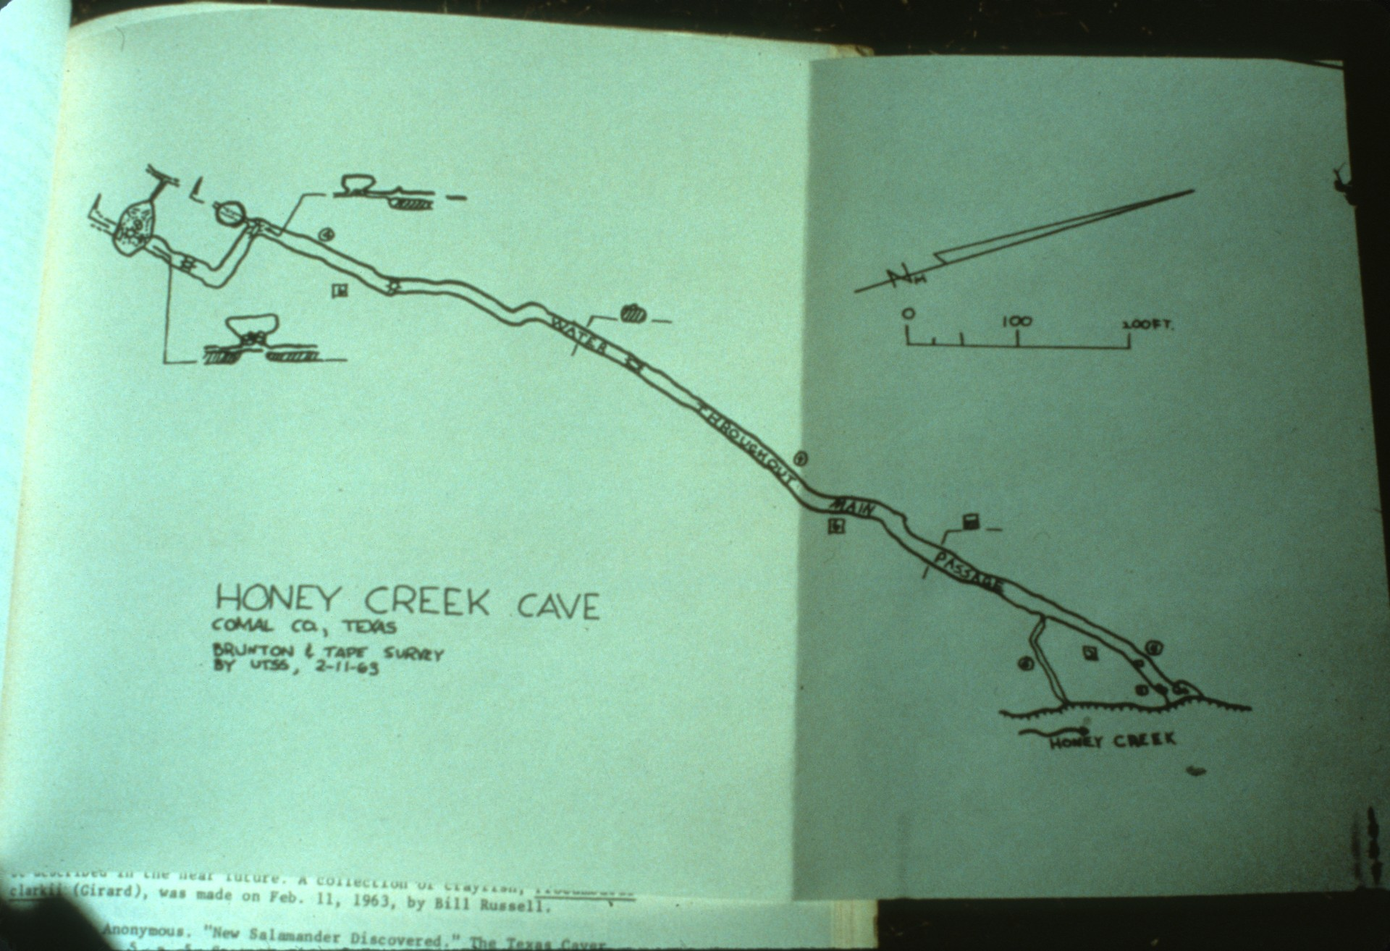
Notes:
The first caver to visit Honey Creek Cave was William Russell in 1961. When he and other members of the University of Texas Speleological Society mapped the cave in 1963, they were only able to explore about 500 meters.

Slide 13
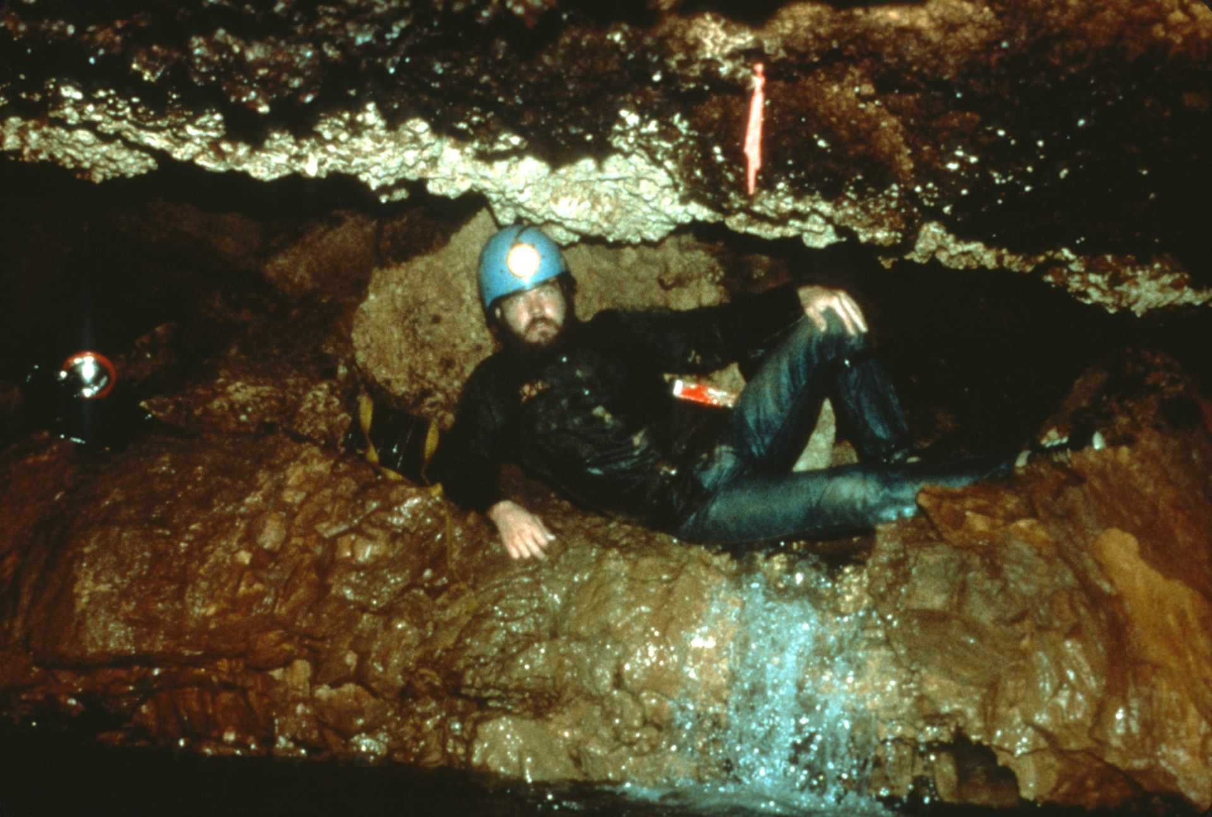
Notes:
480 meters into the cave was a pile of breakdown through which the stream flowed.

Slide 14
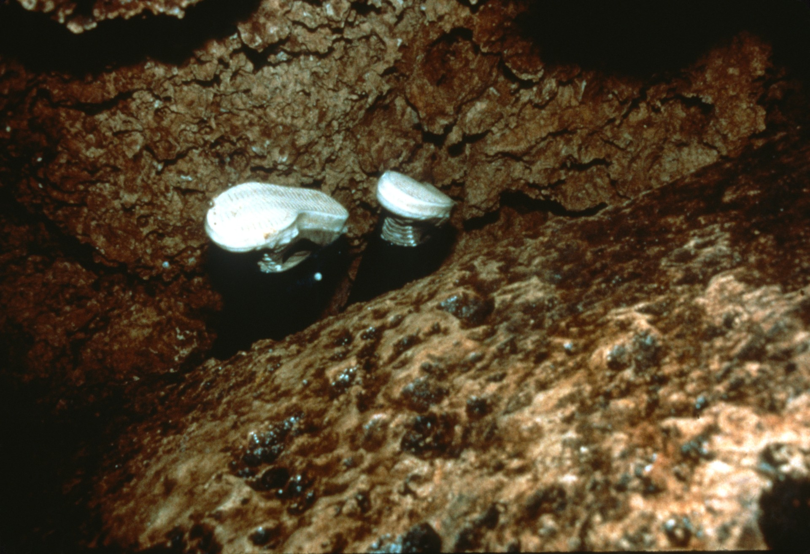
Notes:
A fair bit of poking amid the car-sized blocks yielded an upper room and access to the continuation of the main stream passage.

Slide 15
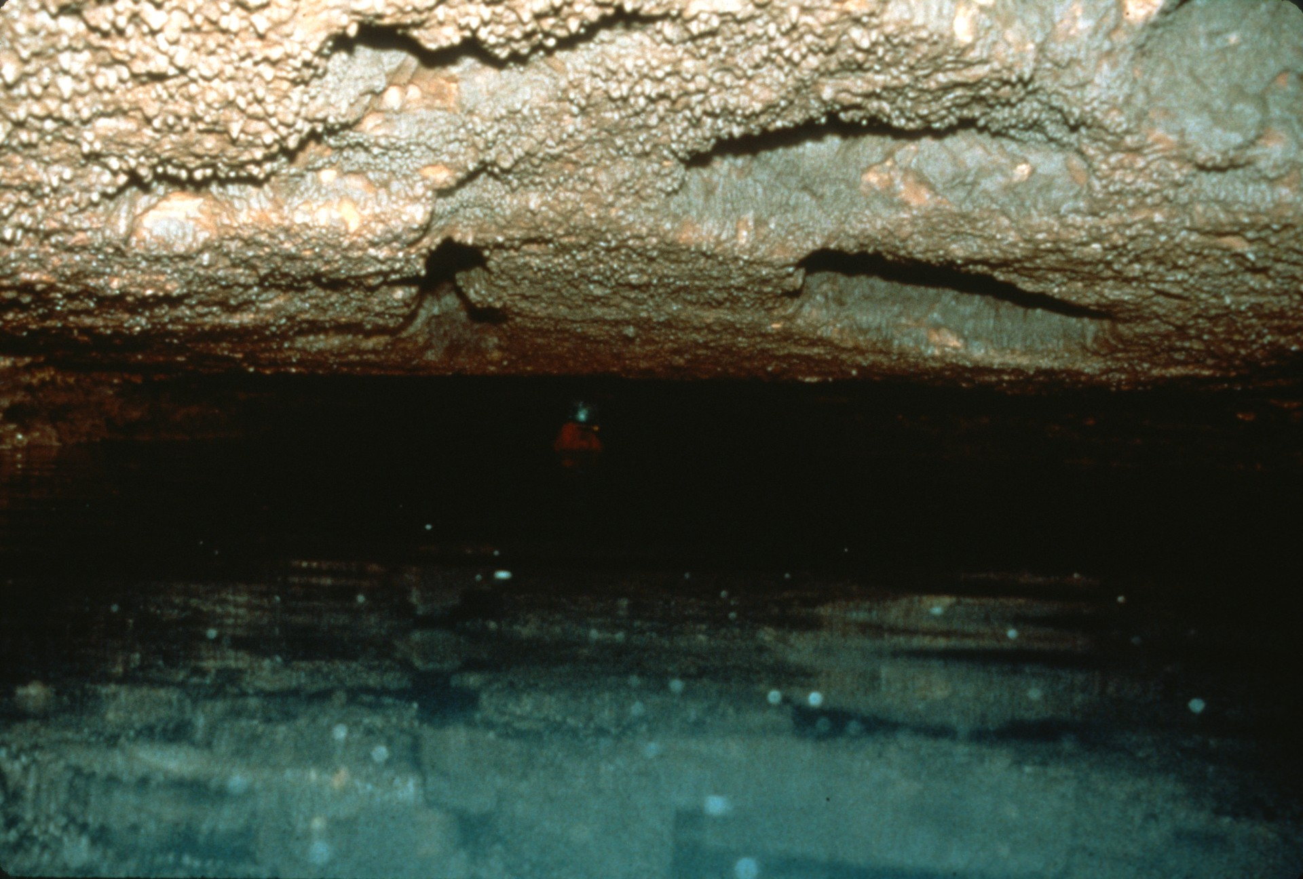
Notes:
The breakdown, however, acted as a dam and raised the stream's water level to near the ceiling. The air flow was still enticing, but without wet suits and good electric lights, Honey Creek was a bit too cold and wet for extensive exploration in those early years of Texas caving.

Slide 16
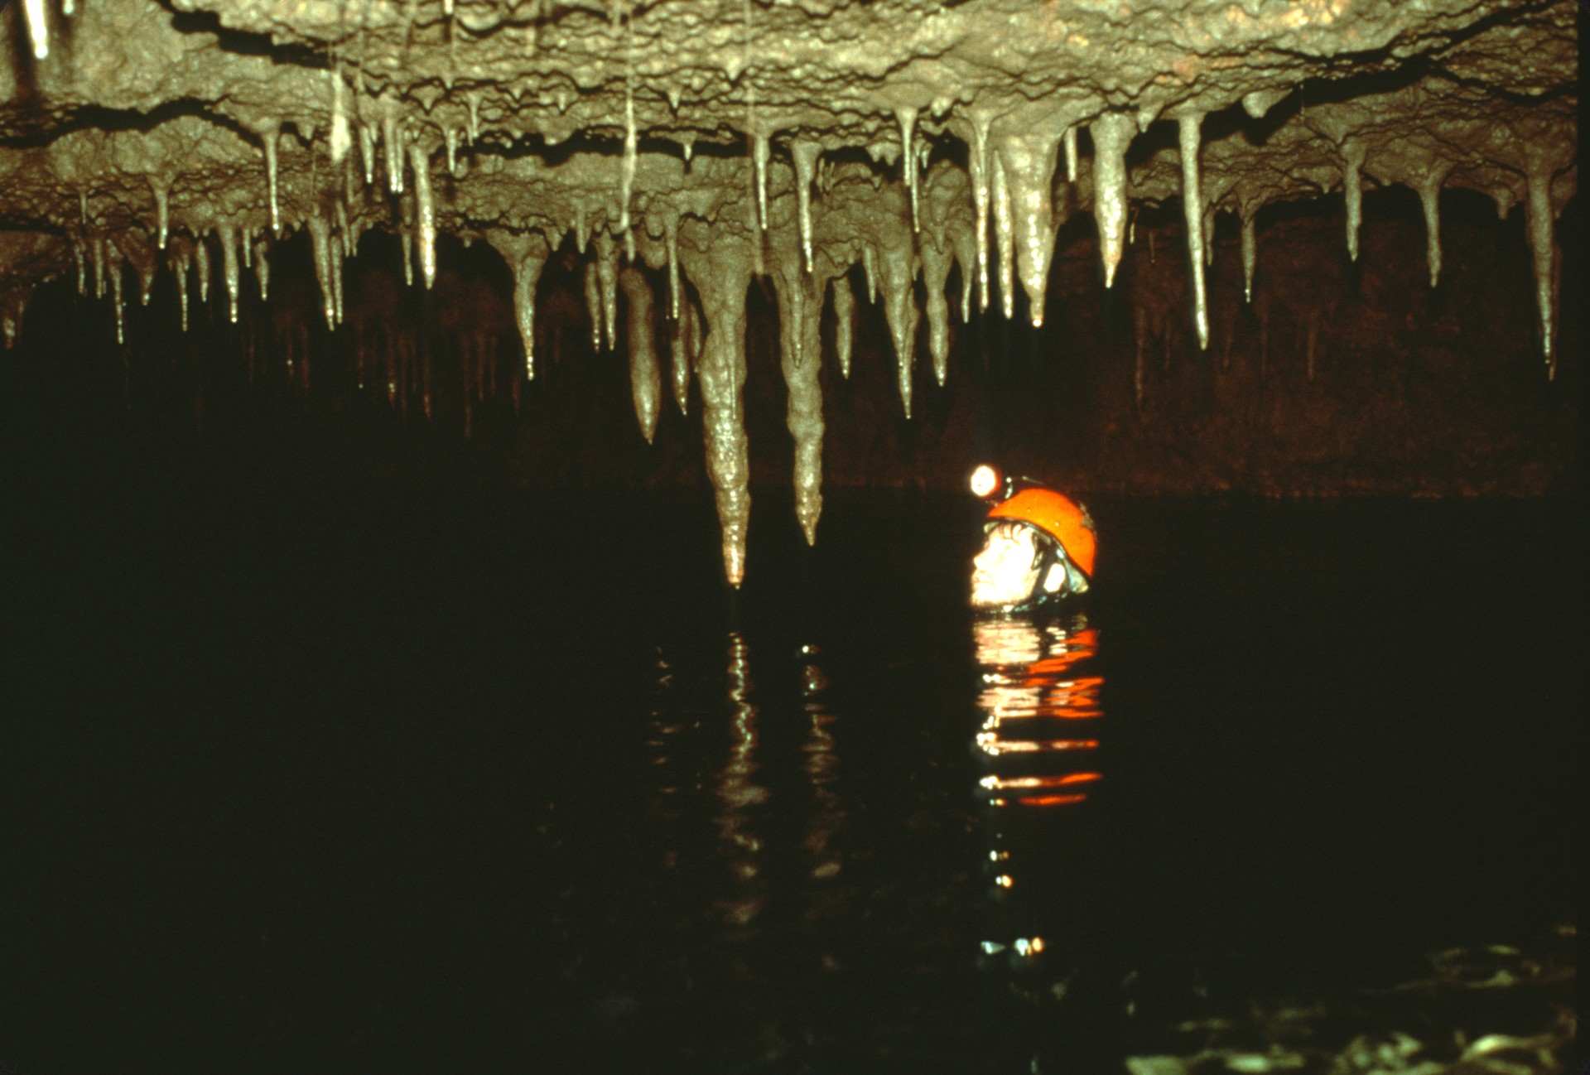
Notes:
By 1980 rumors had been circulating that cavers from east Texas had pushed a long way into Honey Creek. Scott Harden and Gary Poole checked this rumor out. The low air space on the far side of the breakdown persisted for 300 meters before the ceiling rose and the cave continued as it had before.

Slide 17
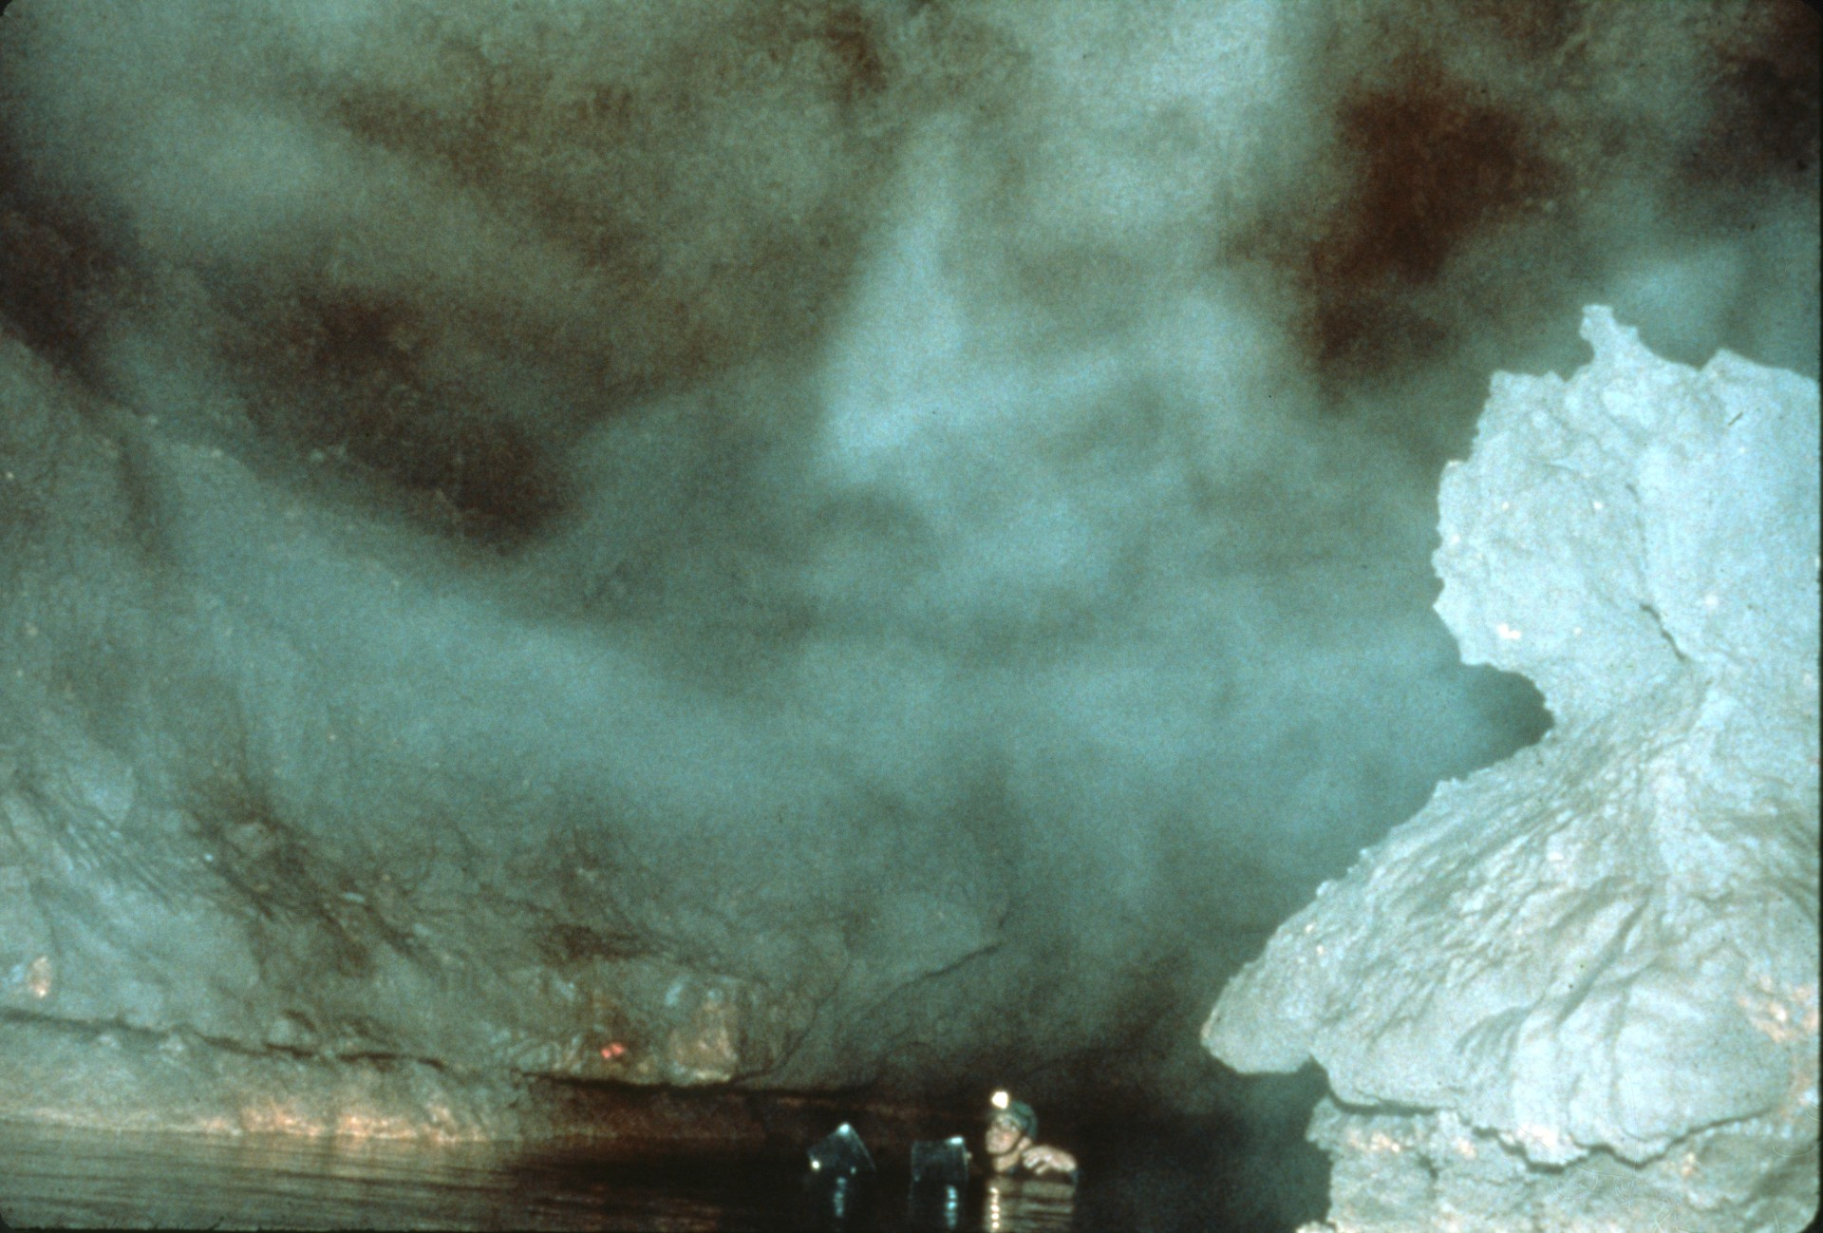
Notes:
In some places the cave became rather large, convincing Harden and Poole there was a lot of surveying and exploring to be done there.

Slide 18
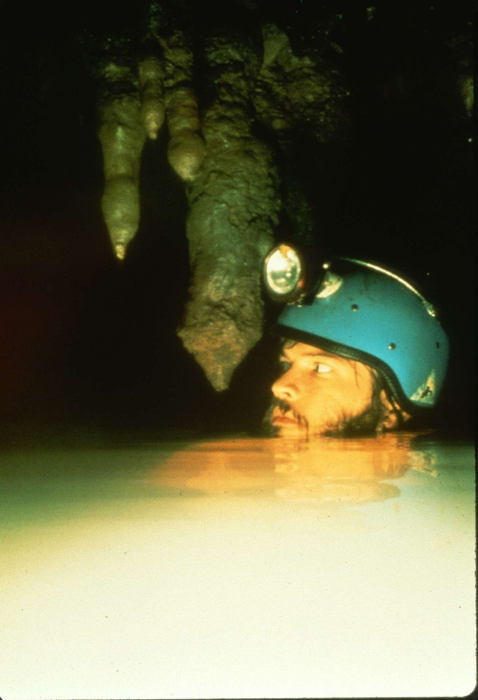
Notes:
The Honey Creek Cave Project began on the weekend of July 4th, 1980. Surveying while treading water was a new skill for everyone to learn.

Slide 19
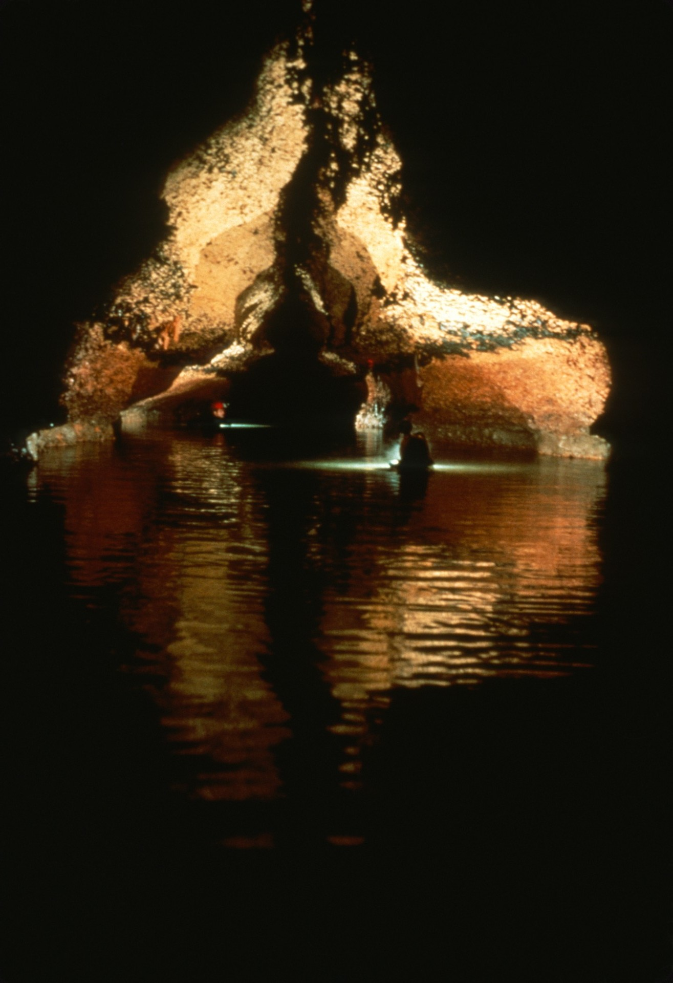
Notes:
During that first weekend 11 cavers worked as 7 teams and pushed the limits of the cave.

Slide 20
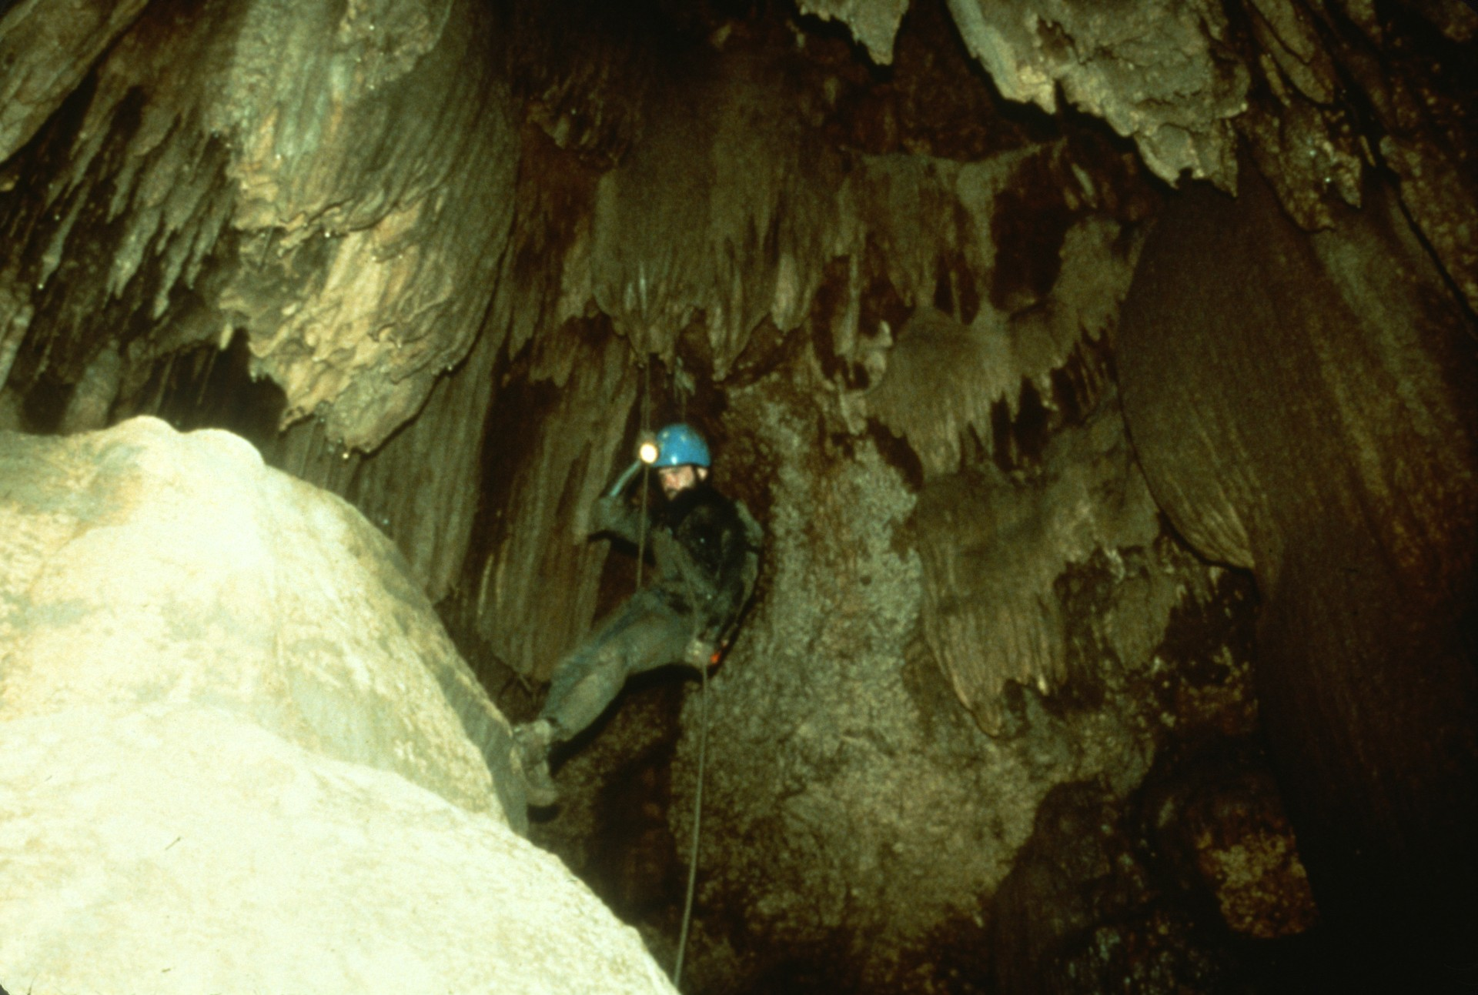
Notes:
The cave was surveyed 1.5 kilometers (nearly a mile) to Mile Dome. This dome, like all others subsequently explored, did not lead to any significant upper level passages.

Slide 21
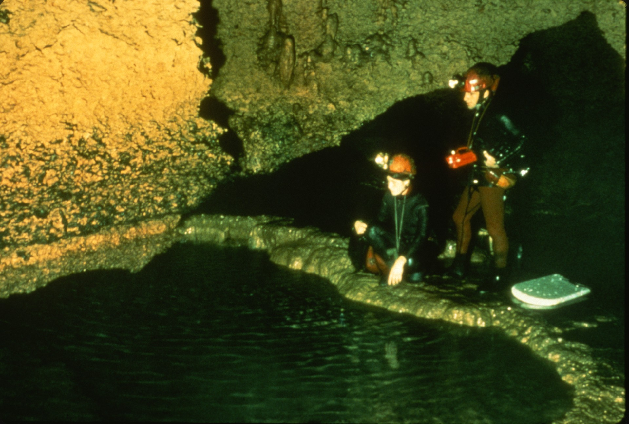
Notes:
Beyond that dome and end of survey, however, the cave was explored an additional kilometer that weekend. The long swims were finally interrupted by large travertine darns spanning the stream. Several side passages were also found and the main passage showed no signs of letting up. It was obvious that Honey Creek was indeed a major cave which would take a lot of work to explore. Since that time there have been no other trips into the cave solely for exploration. The ethic is to "survey as you explore." Thus each survey trip into the caves guarantees a journey to "where no man has gone before."

Slide 22
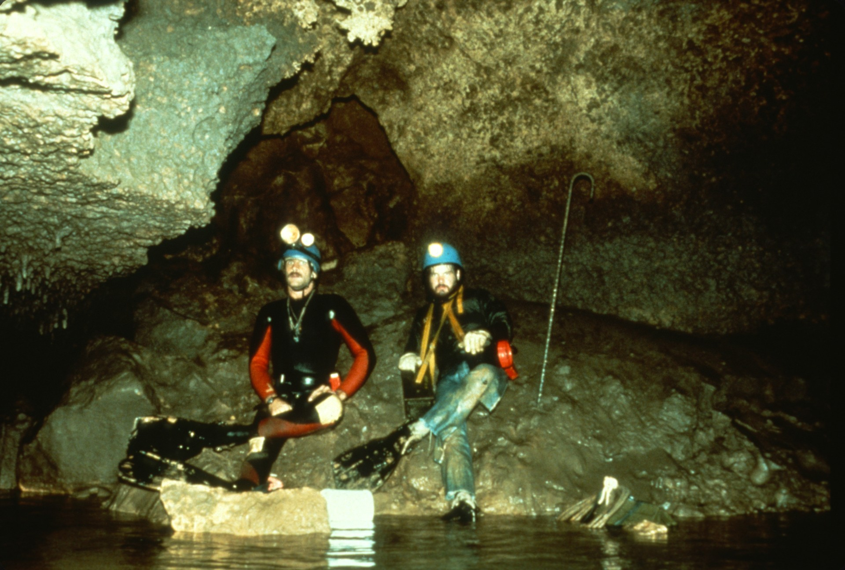
Notes:
The cavers pushing Honey Creek had combined experience covering most of the U.S., Mexico, and other countries. Yet Honey Creek was unlike any cave anyone had experienced before. New standards and styles of caving were set for Honey Creek. Sealed compasses and plastic survey books were exclusively used. A full wetsuit was essential. Some preferred protective clothing over their wet suit and others did not. Big fins became standard equipment as did electric lights. Where carbide lights were used, so were piezo-electric lighters. Ammo boxes, Styrofoam boards and plastic air-filled bottles were used to rest your chin on so you could lie prone in the water and let your finned feet propel you along.

Slide 23
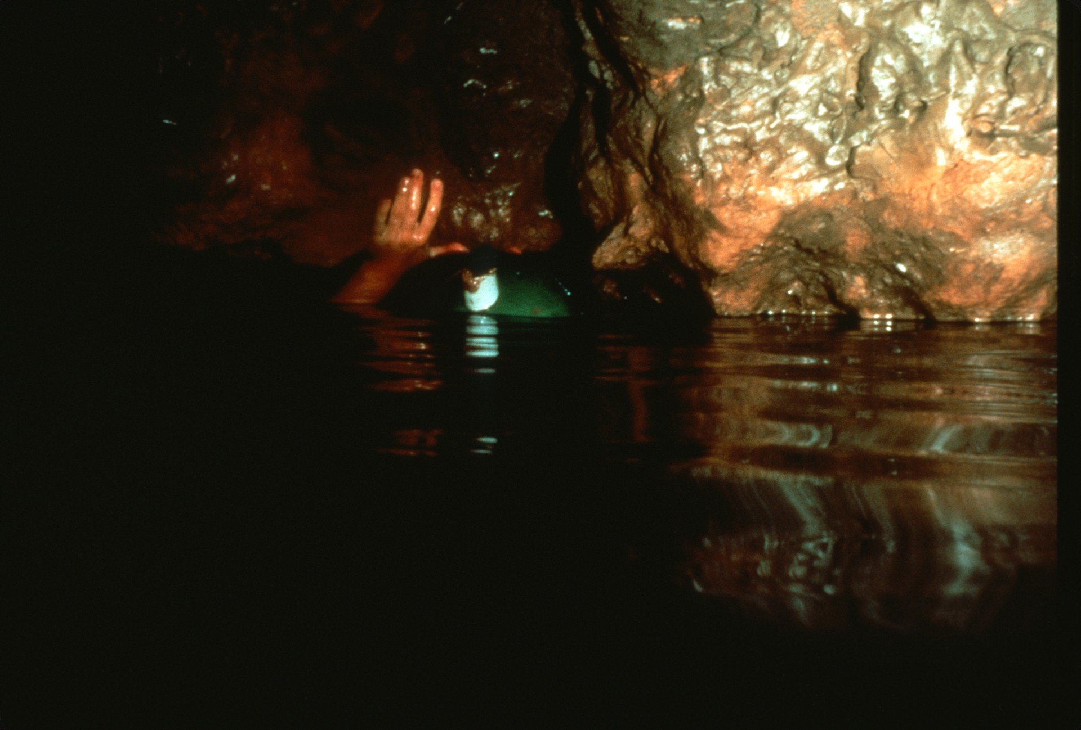
Notes:
New standards were also set as cavers pushed the limits of what was considered acceptable air space. This is reflective in the names given to certain parts of the cave: "Wet Lips," "8 Meters of Grimmness," "I Can’t Hear You, My Ears Are Filled With Water Passage," and "The Ultimate Air Space."

Slide 24
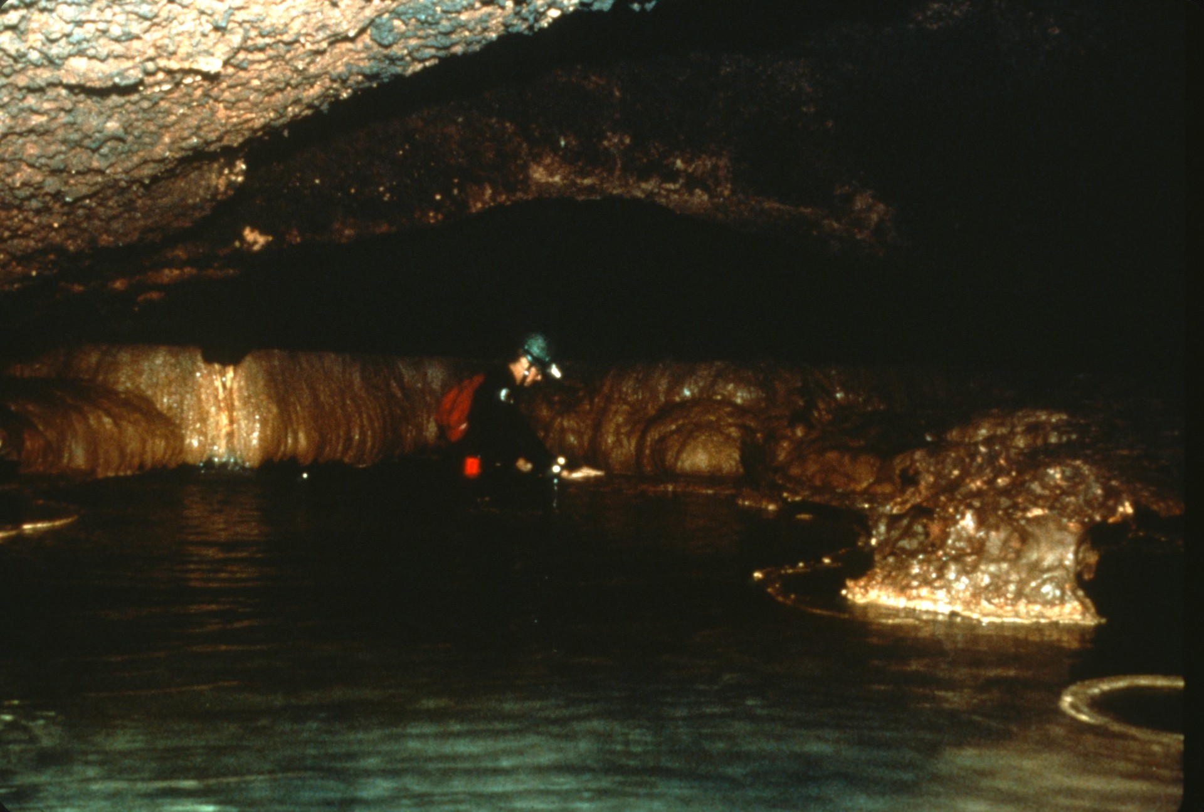
Notes:
In spite of the jokes ("In low air space no one can hear you scream!") and the bravado ("Air space is for wimps!") that accompanied pushing low air, there was the reality that some air space was simply too low to push. So the last technique in exploring Honey Creek Cave, as shown at the right side of this slide, was to notch the dam and lower the water level.

Slide 25
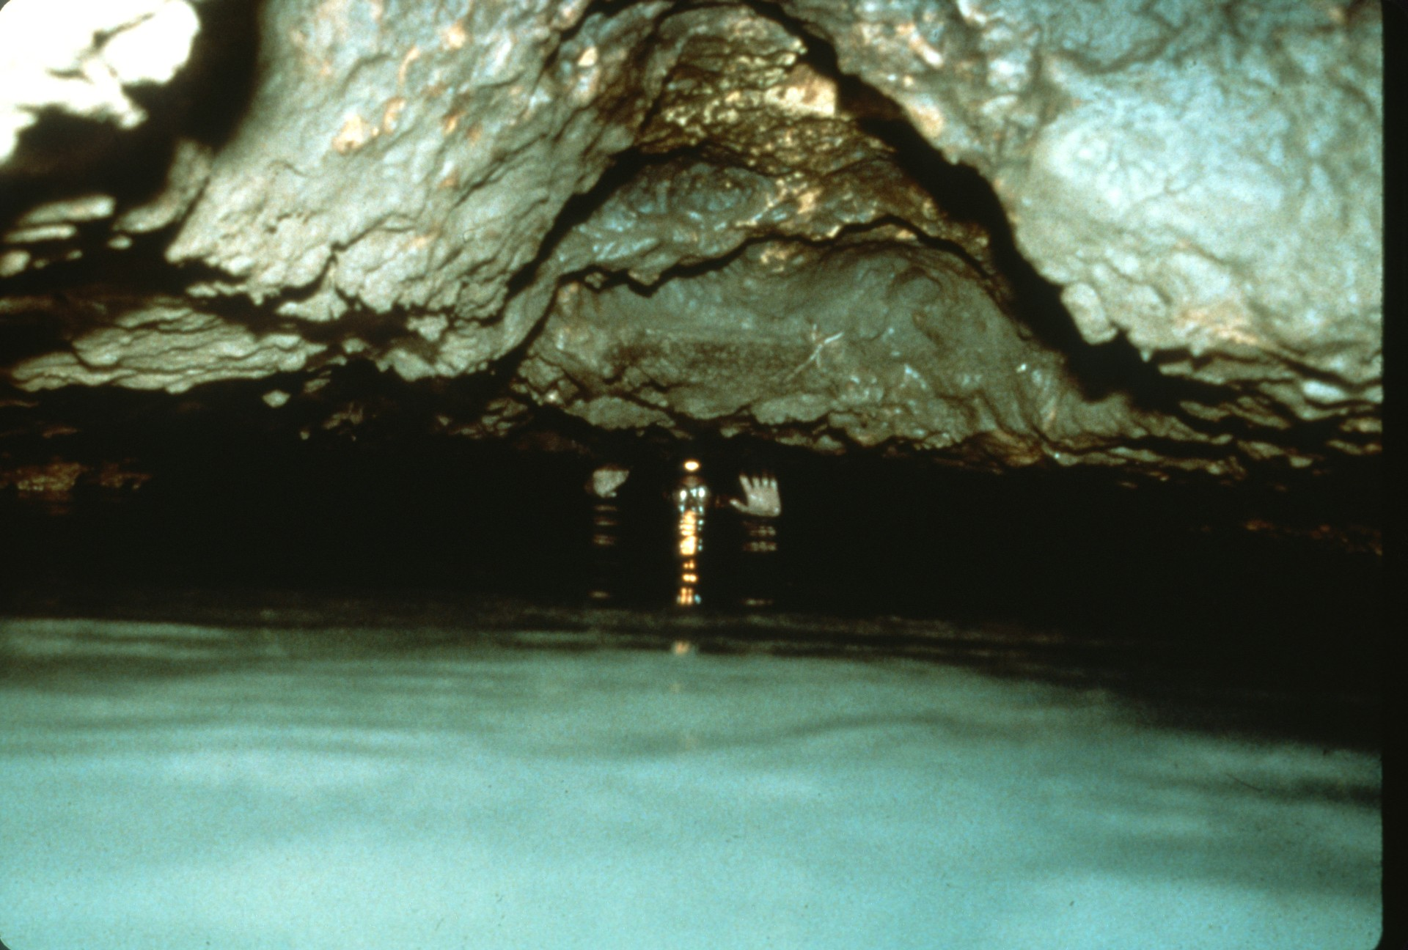
Notes:
The main section had been surveyed for 3 kilometers to this low air section called "Yo Mama". The air that blew through the narrow gap between ceiling and water indicated there was a lot more cave ahead. While some felt there was no justification to alter the cave, it was noted that the cave was actively building and destroying dams, the hydrology and ecosystems would not be affected, and the potential for more cave was tremendous. The notch was cut just deep enough to allow safe exploration.

Slide 26
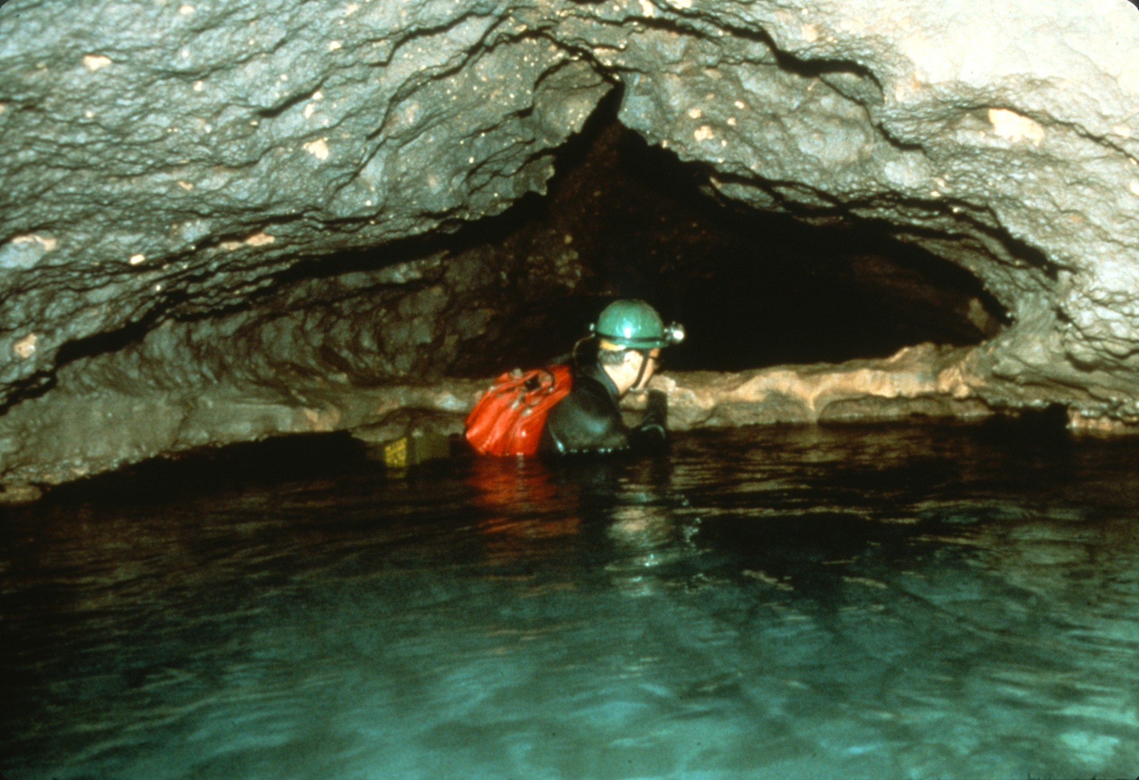
Notes:
On the other side of Yo Mama the cave decreased in size. The swimming was finally over and the fins could be abandoned here at the "Flipper Bridge."

Slide 27
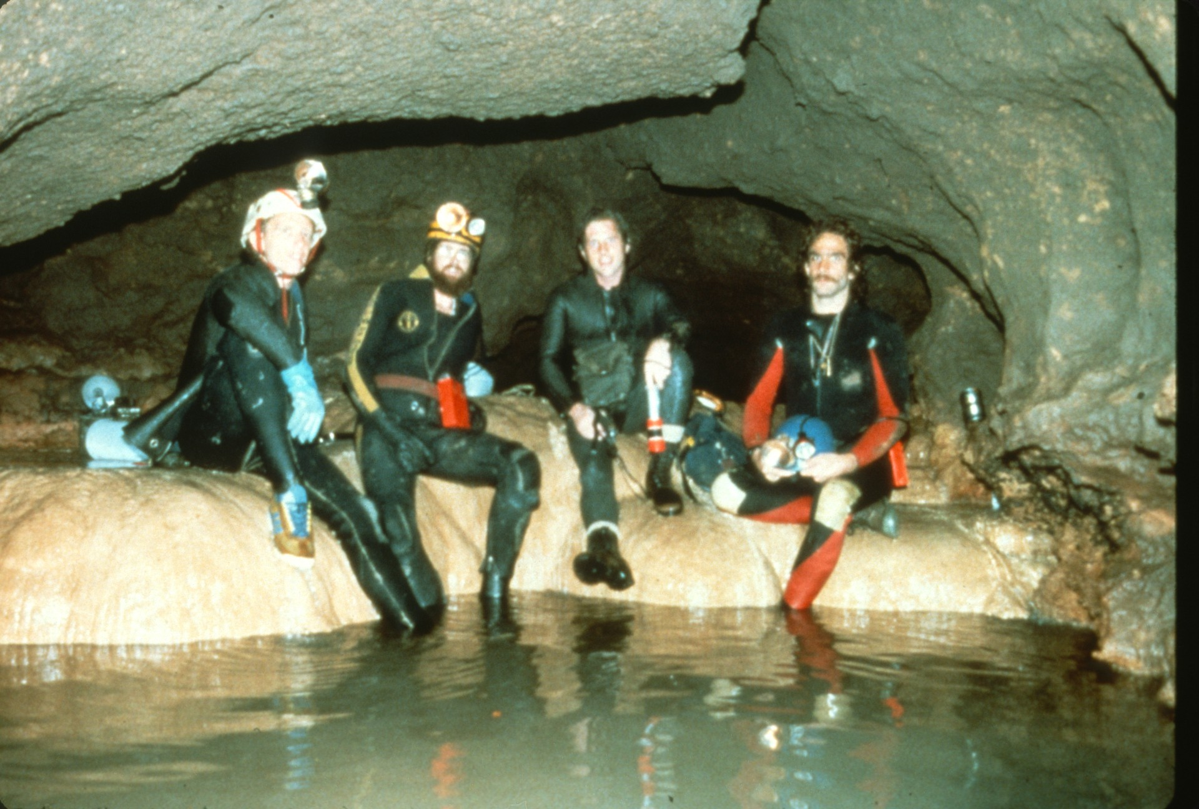
Notes:
Wading up the passage for 700 meters led to the "Trifurcation," a major 3-way junction and the farthest point of exploration in 1980.

Slide 28
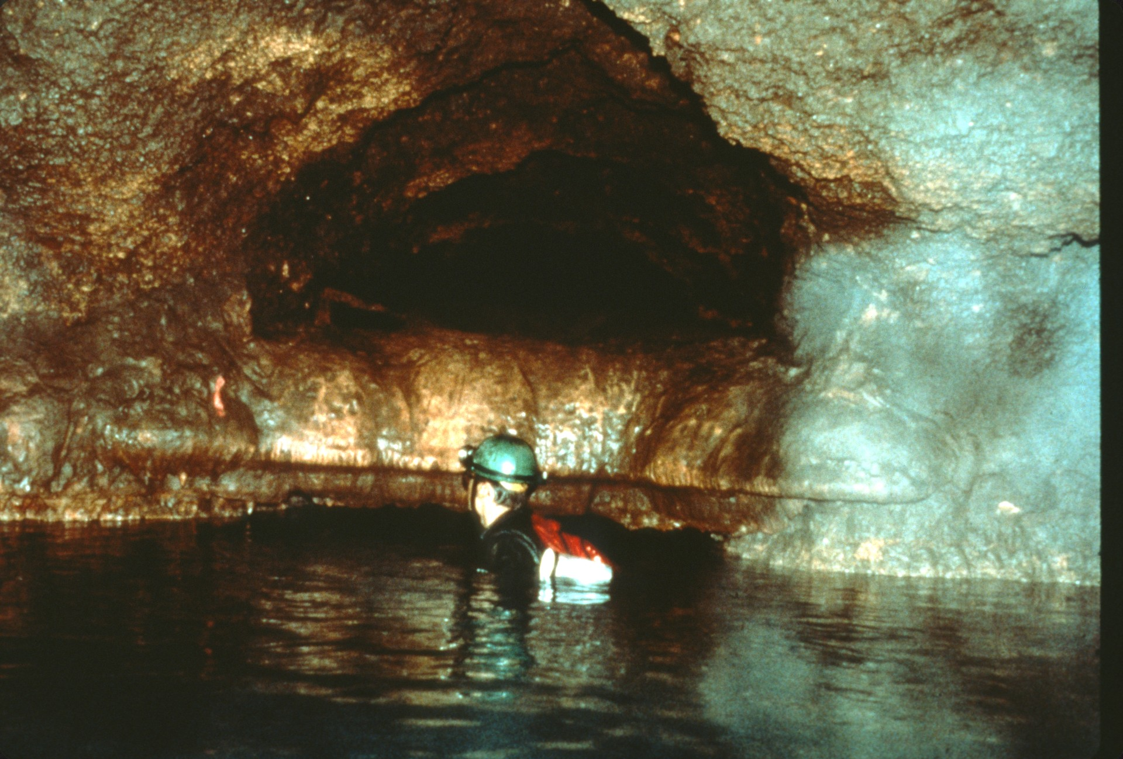
Notes:
In 1981 exploration began to focus on leads closer to the entrance. The first such lead was the QA Survey, a side passage situated just downstream of the breakdown in the "historic" part of the cave.

Slide 29
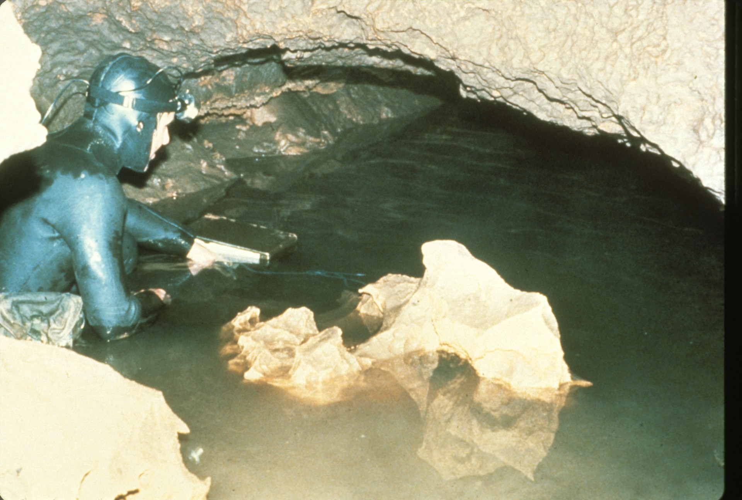
Notes:
In 1980, as during the 1963 survey, the QA was followed a few meters to a sump. In 1981 Randy Waters used SCUBA and dove for 30 meters to the sump's far side. Later in 1981 the water level lowered and allowed exploration without the use of SCUBA.

Slide 30
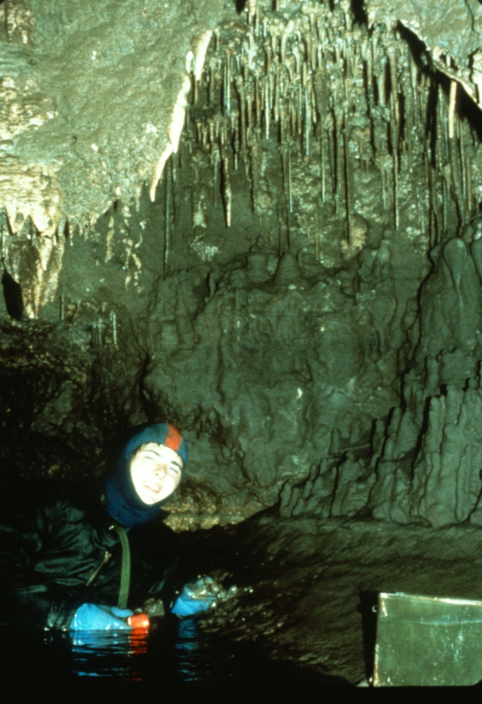
Notes:
The QA was surveyed 700 meters before reaching a sump. It was typical Honey Creek side passage in that no swimming was needed, but atypical in being relatively free of mud.

Slide 31
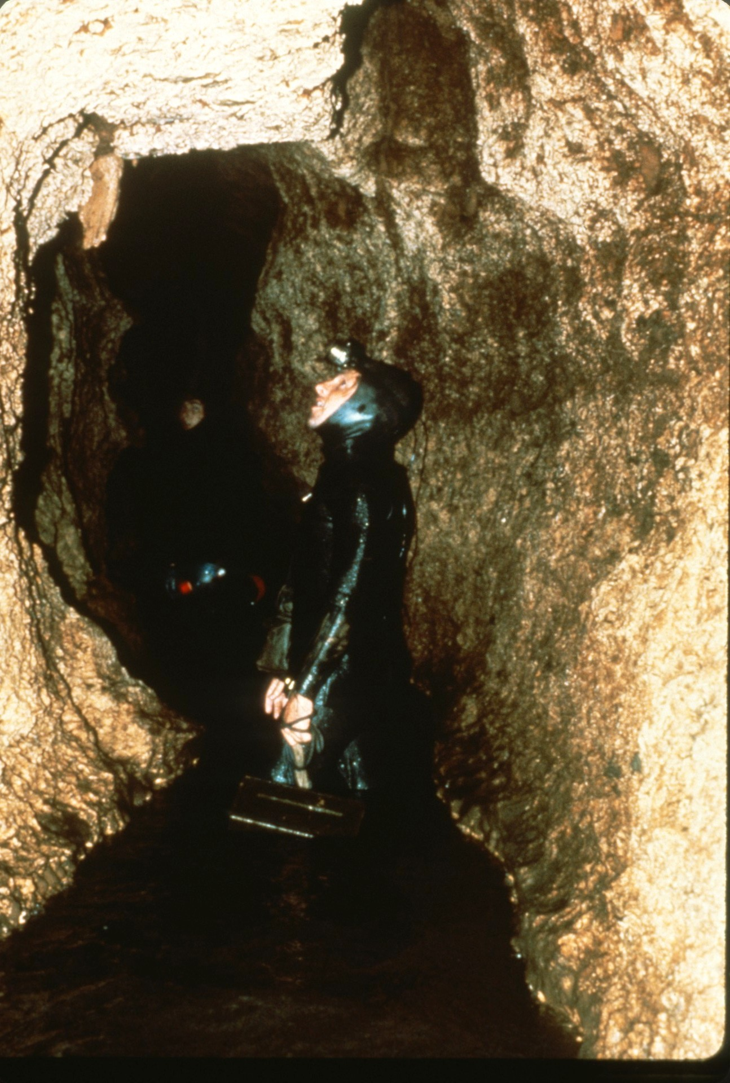
Notes:
In contrast the N survey was a side passage that had plenty of mud.

Slide 32
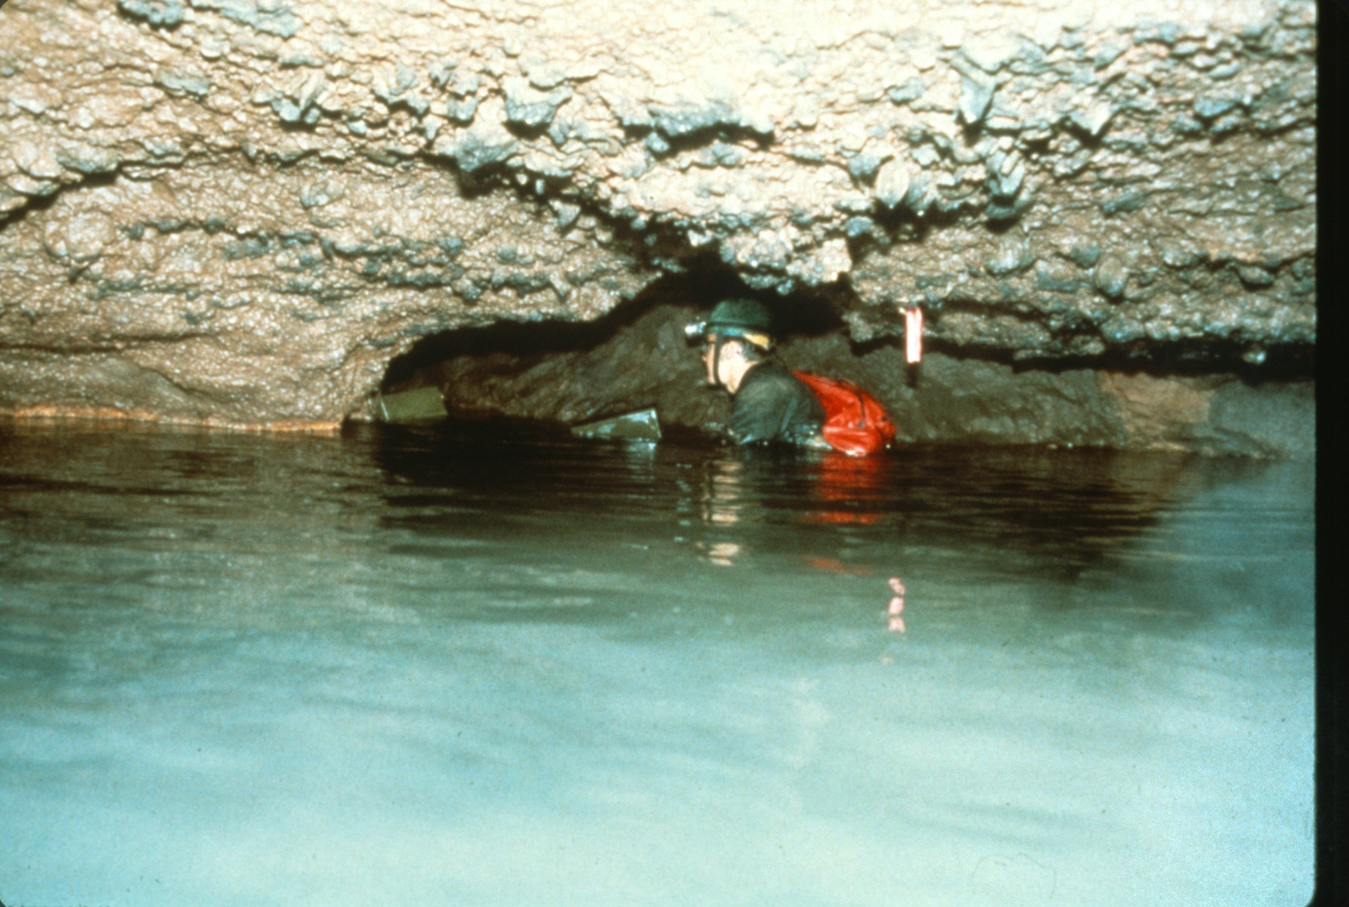
Notes:
The N was like most side passages in being located at the main stream level. When water in the main stream rises and floods the side passages, all the mud gets left behind. Some of the side passages in Honey Creek would be quite large if not for all the mud filling them.

Slide 33
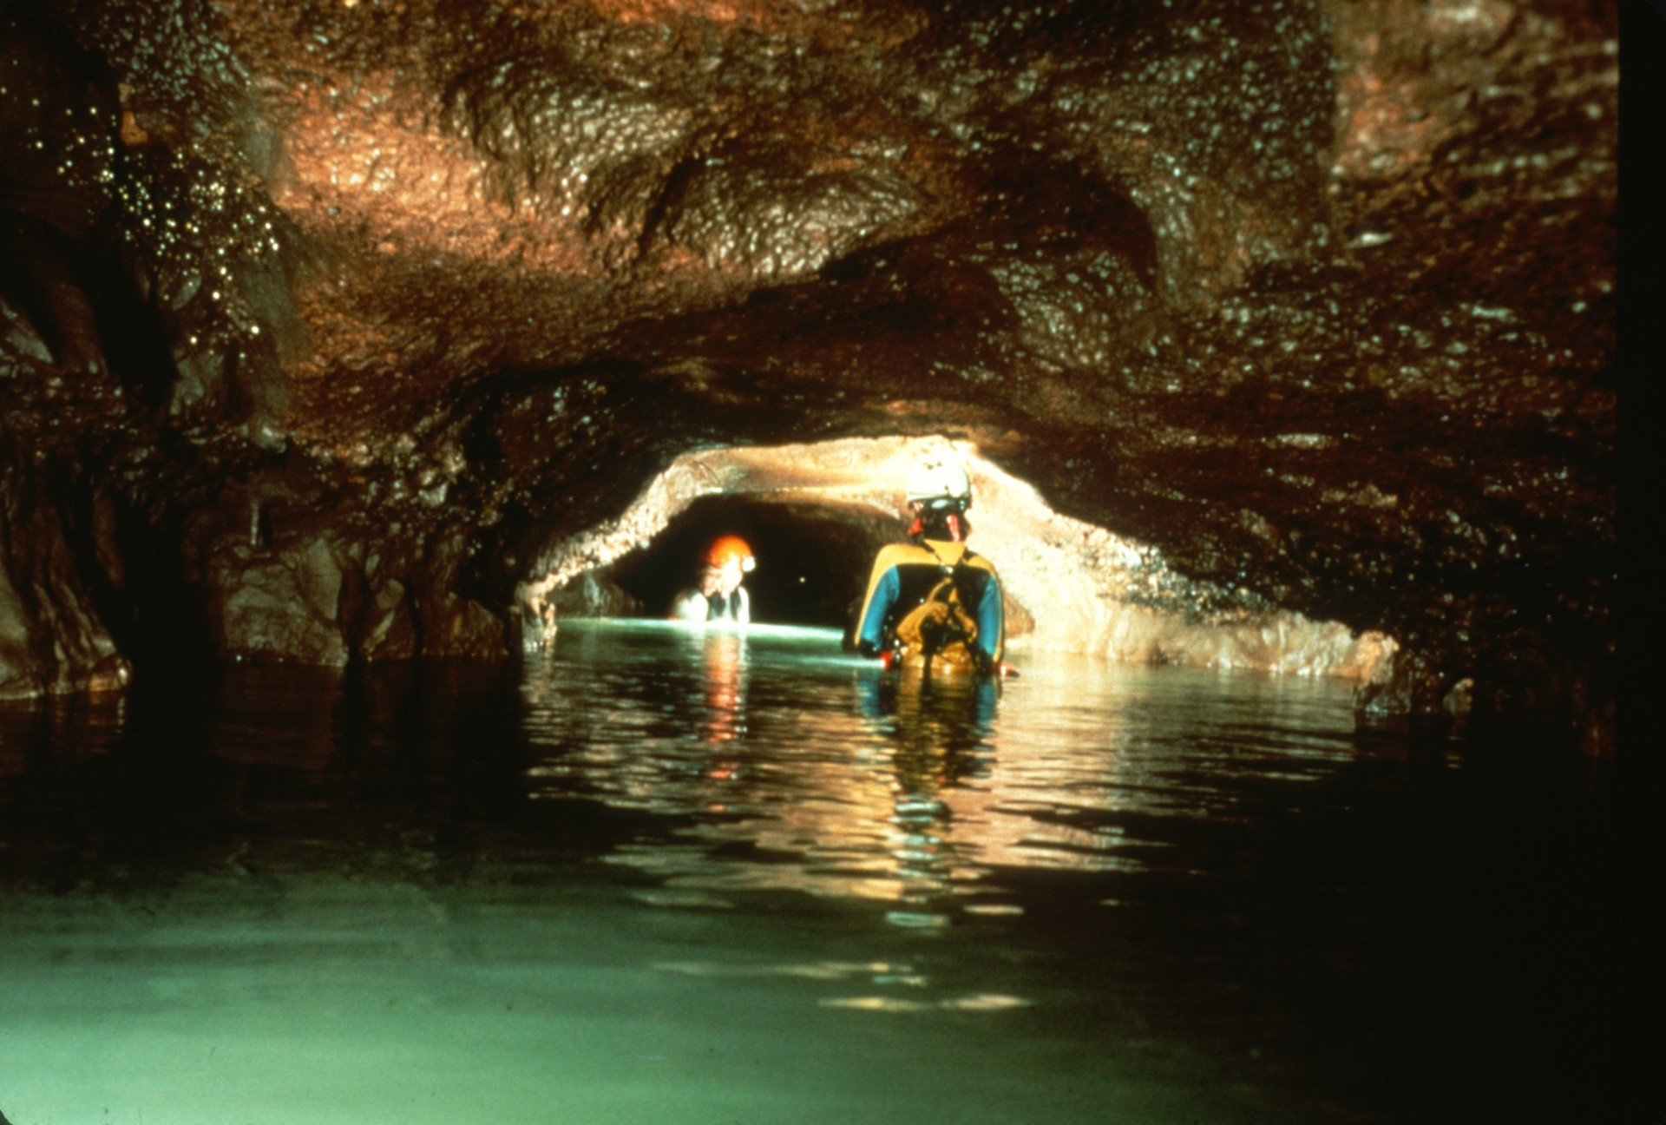
Notes:
In 1982 attention was again turned to the back end of the cave. Teams explored the two in-feeding passages at the Trifurcation, and pushed up the main stream.

Slide 34
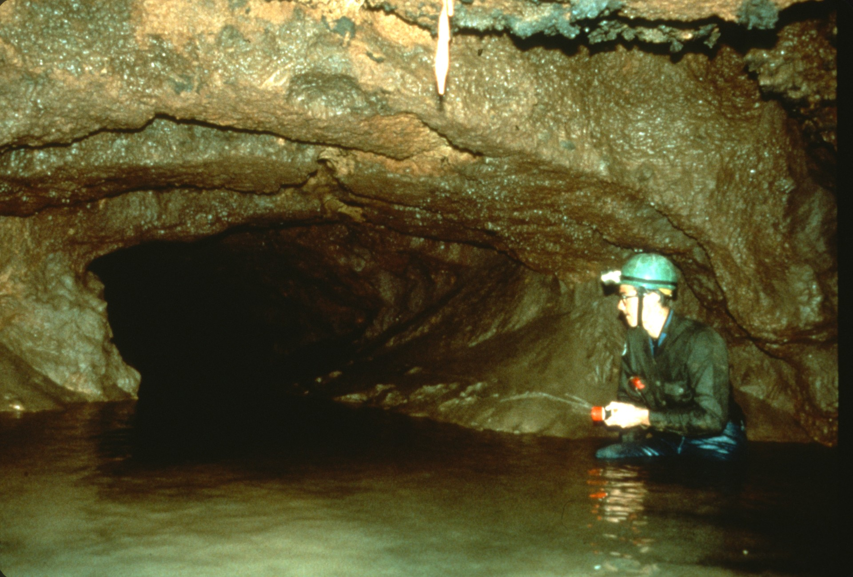
Notes:
One kilometer further into the cave a major passage junction was found -- the Bifurcation. At this point the cave split equally between two passages.

Slide 35
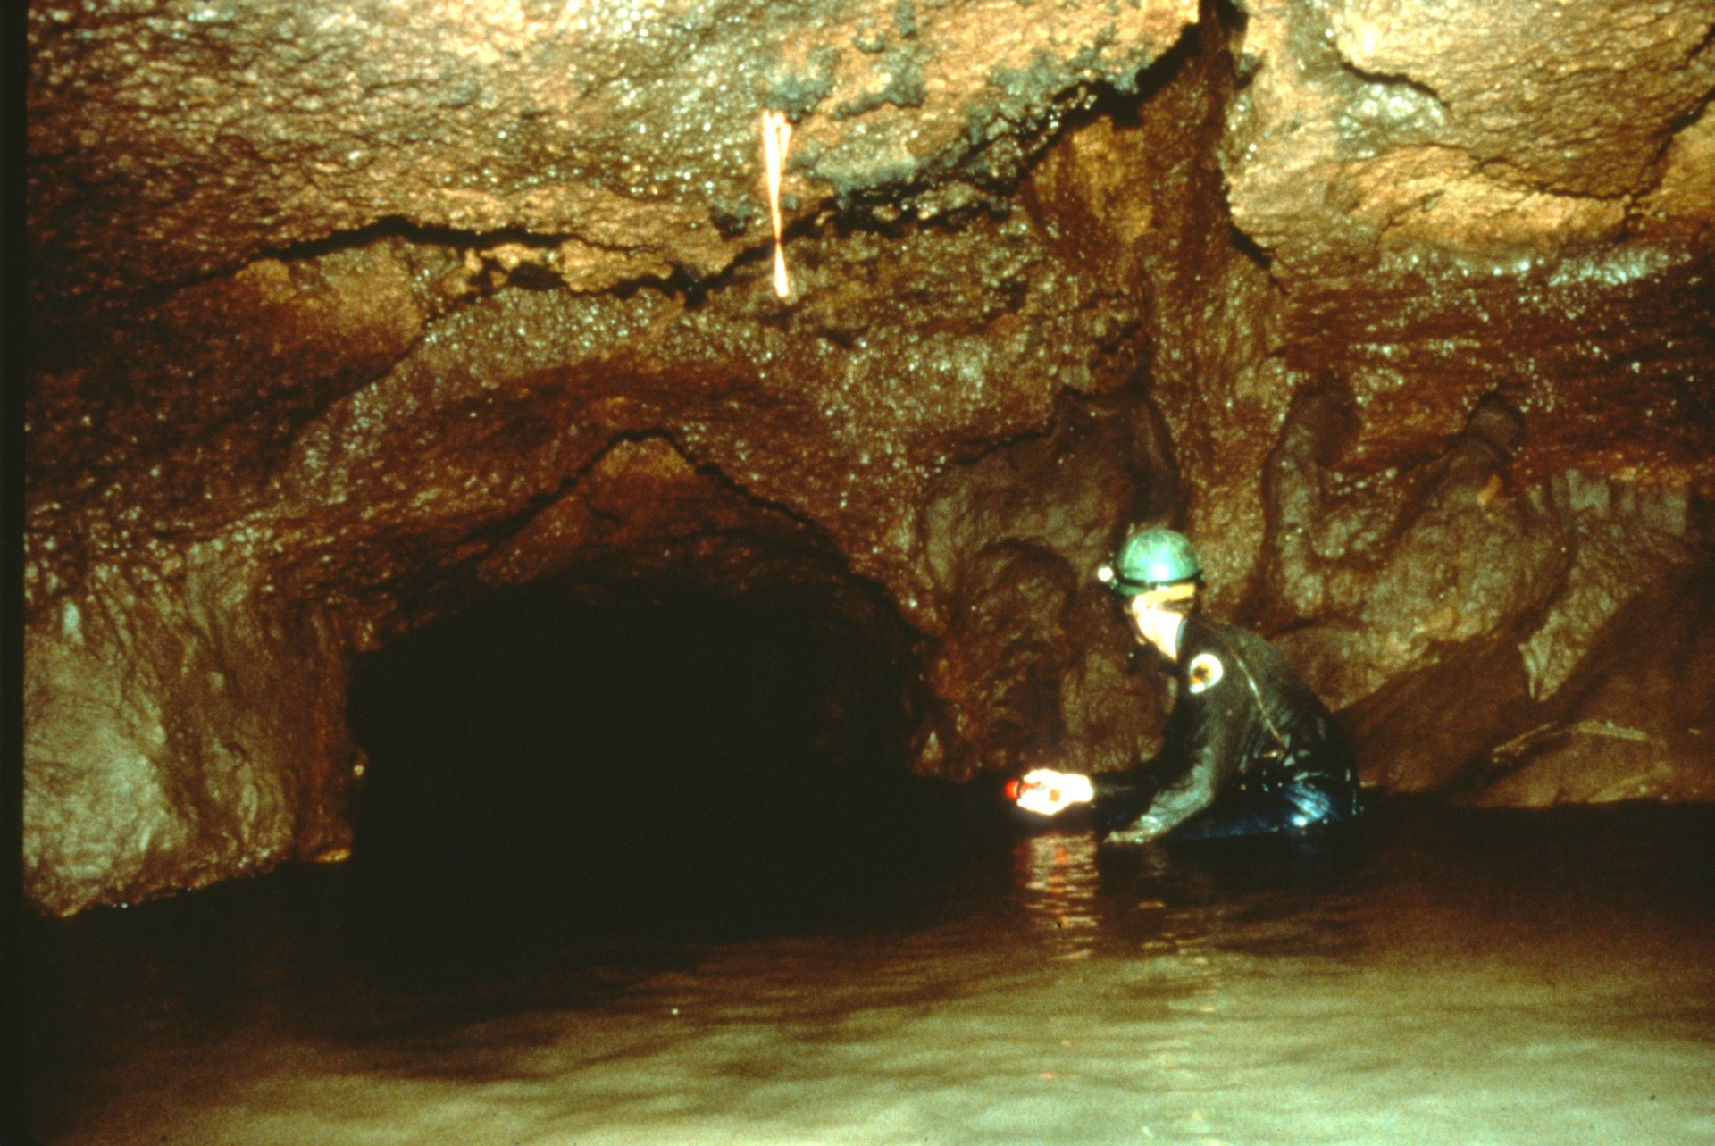
Notes:
One of the passages headed northwest. The other passage continued southwest and so did the exploration, following Honey Creek's main trend.

Slide 36
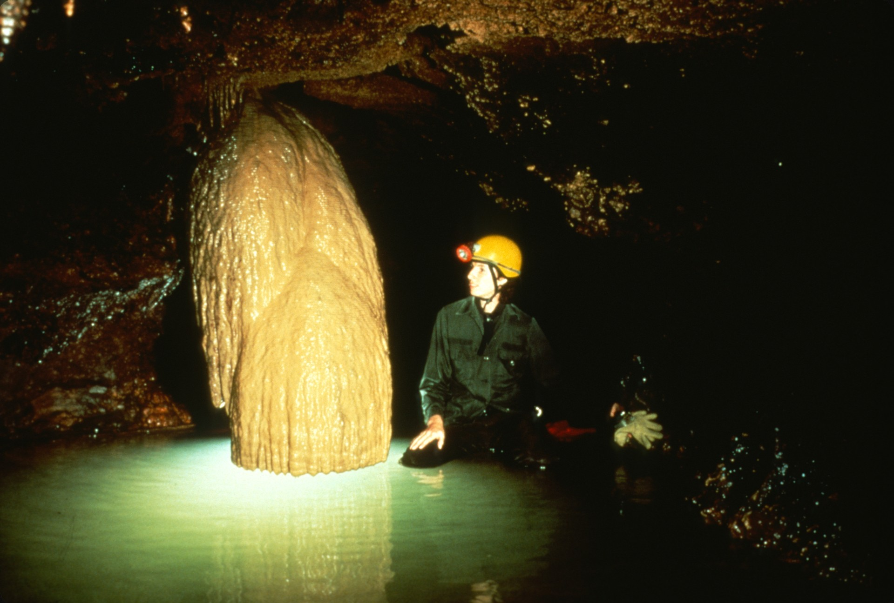
Notes:
The cave continued onward past some nicely decorated areas...

Slide 37
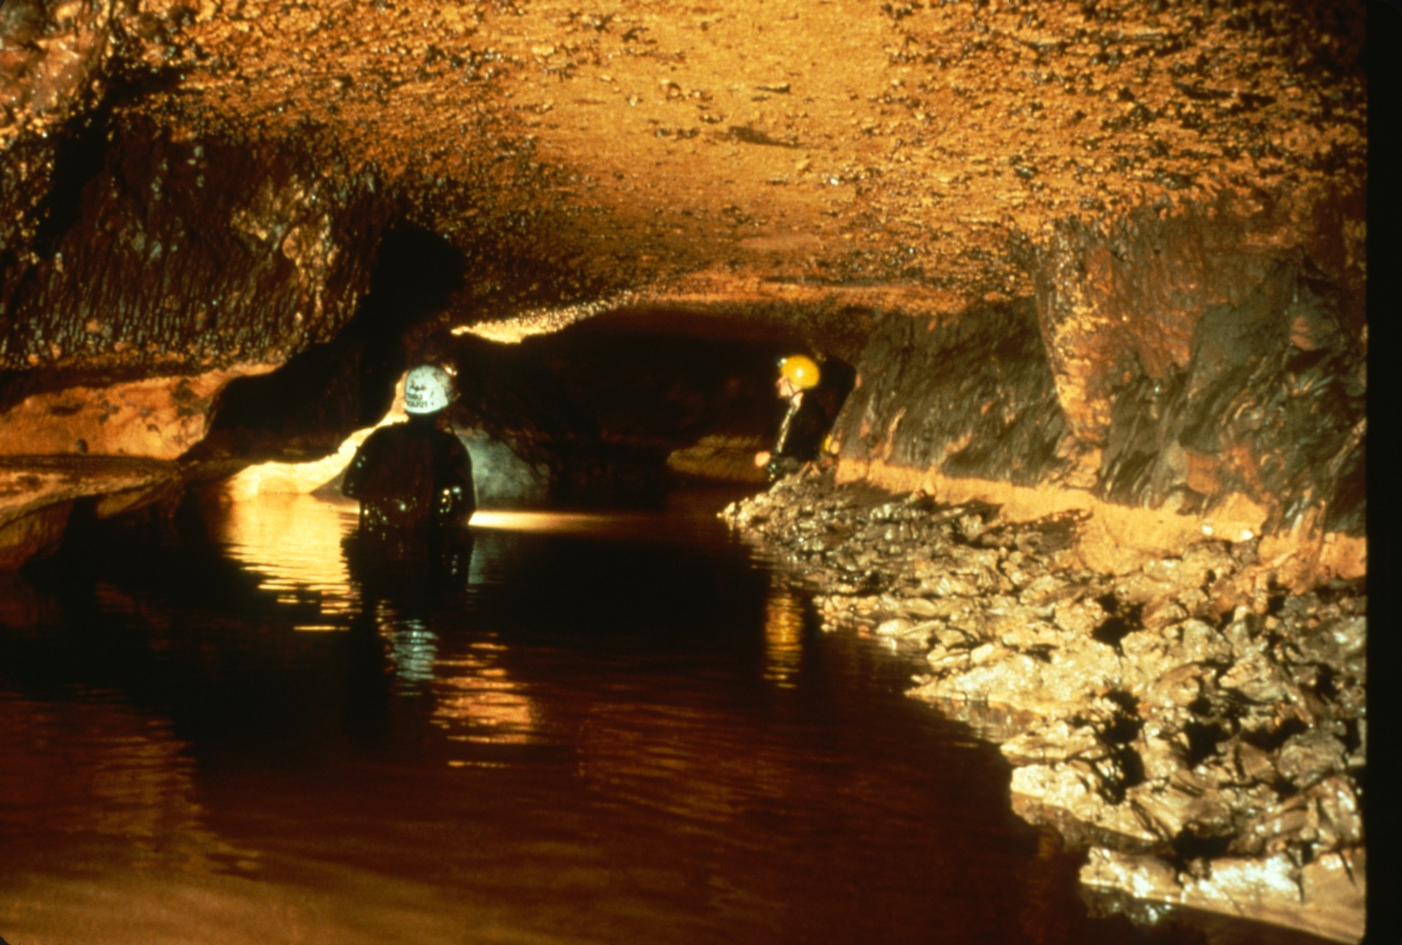
Notes:
…but eventually the passage grew smaller. Swimming had given way to wading, which gave way to stooping...

Slide 38
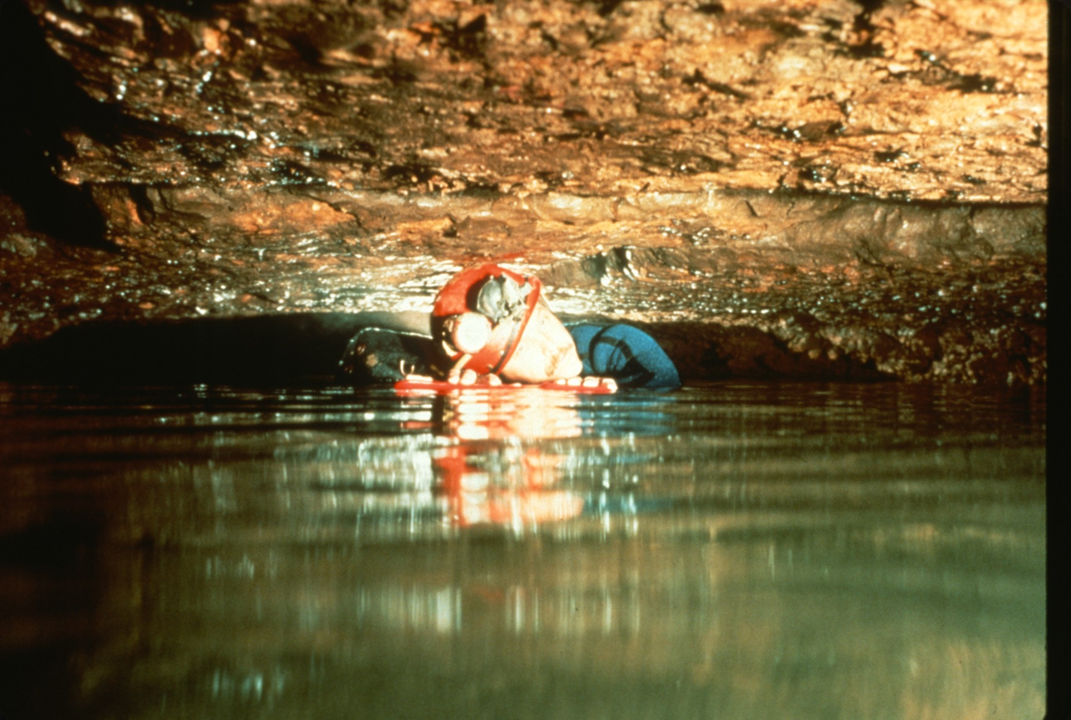
Notes:
…which led to “salamandering.” Salamandering is a very efficient technique of exploring shallow water, low-ceiling areas. Cavers allow their wet suits to float their bodies up while their hands reach down into the mud and pull them forward in a steady salamander-type motion.

Slide 39
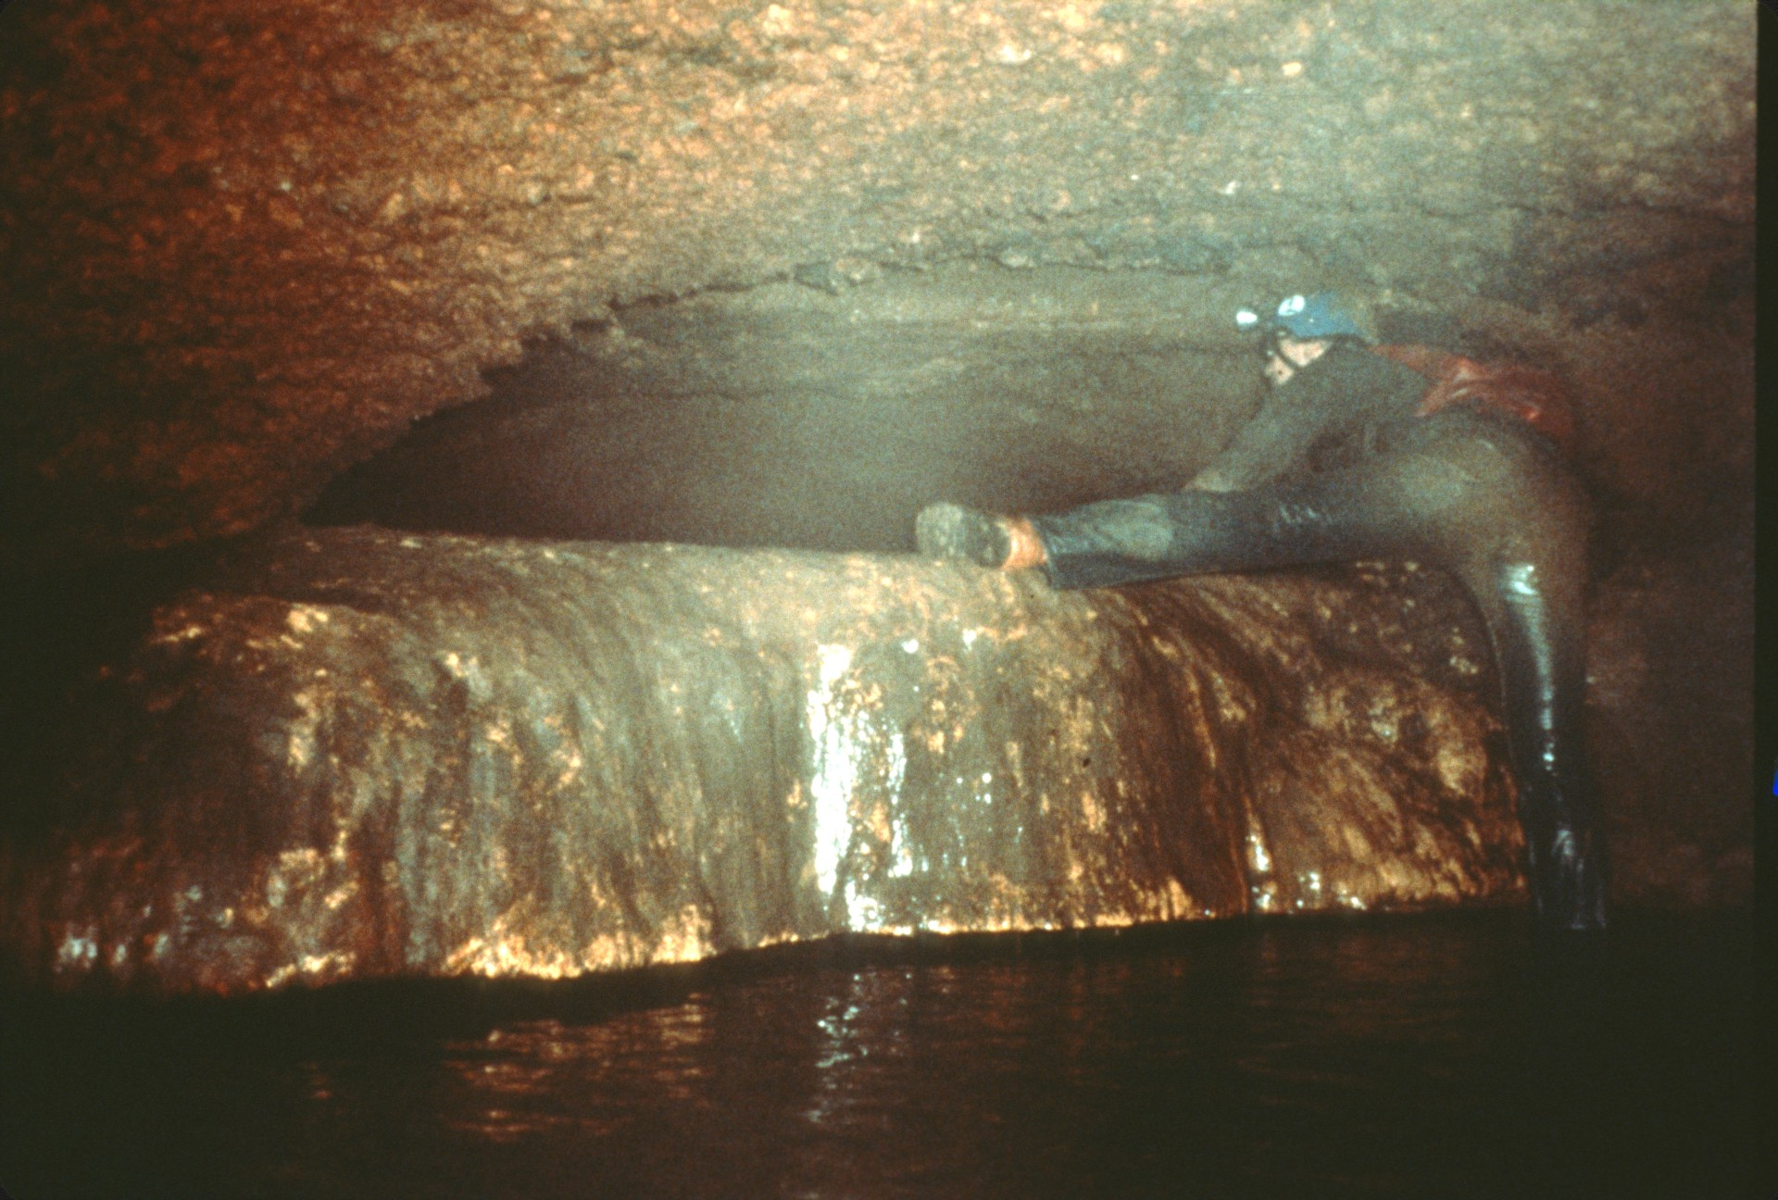
Notes:
Eventually the water became too shallow to salamander, and the fight was on: cavers vs. boot-sucking mud. After 86 meters of "Tu Mudre" the passage climbed out of the mire and led to another side passage . . .

Slide 40
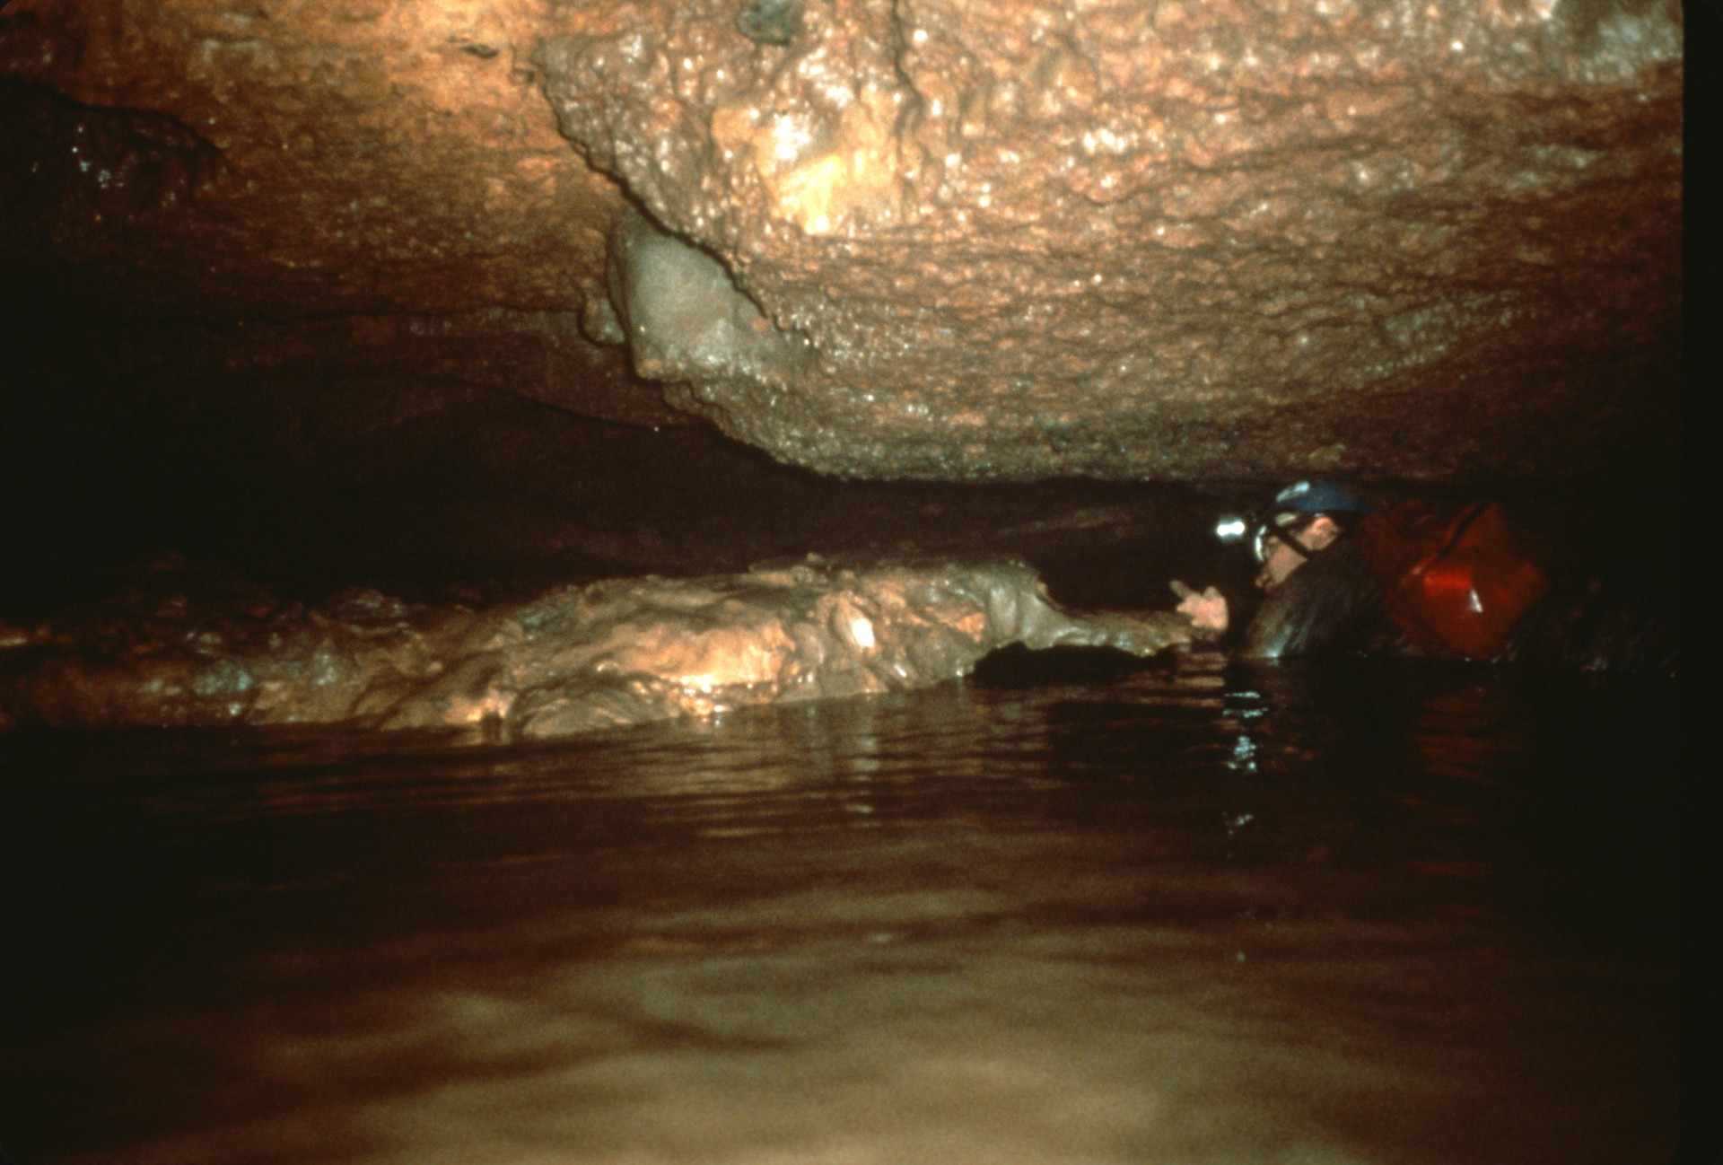
Notes:
…or was it? A closer look revealed a groundwater divide had been reached. One third of the water from this passage flowed back, toward the camera, to the cave’s entrance, and the other two-thirds flowed off to the left...

Slide 41
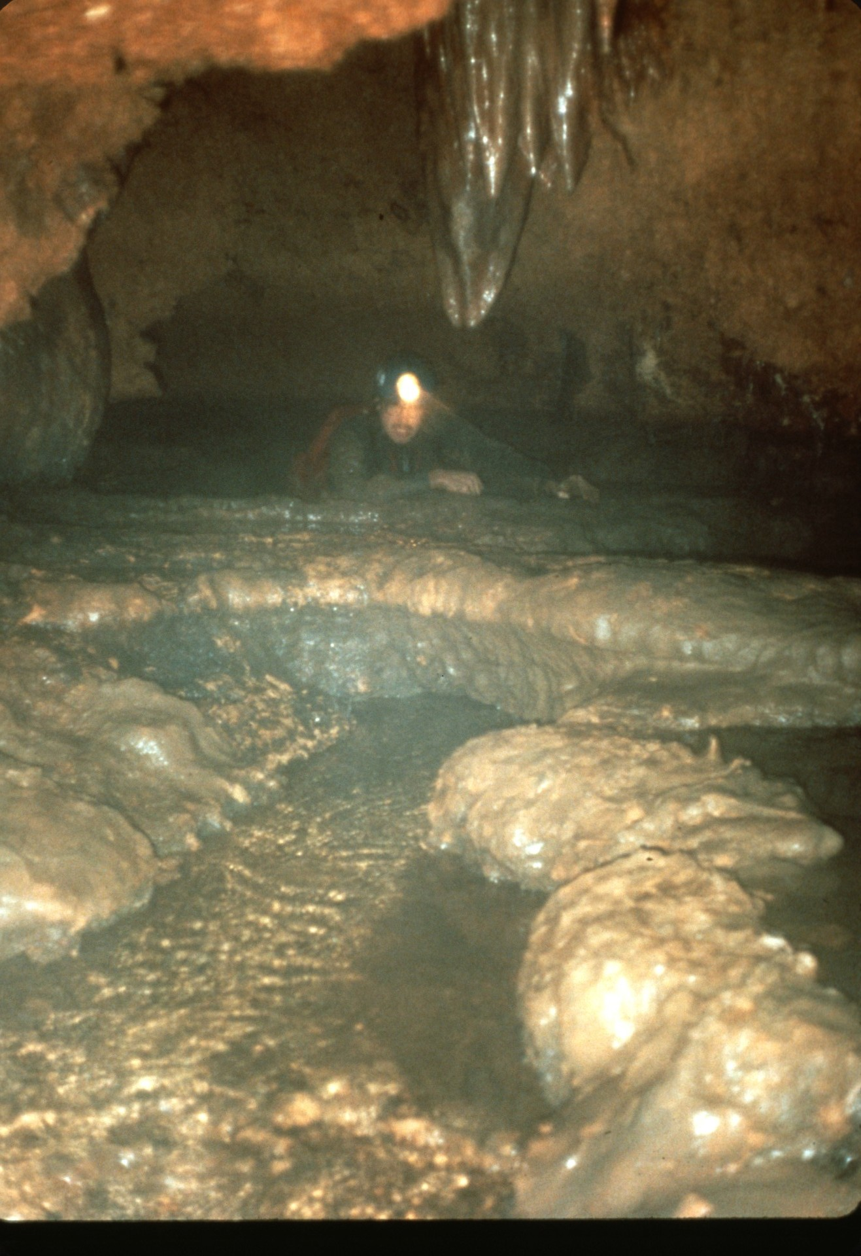
Notes:
…and down some travertine dams into parts unknown. Would a mirror image of the known cave be found on the other side of this divide?

Slide 42
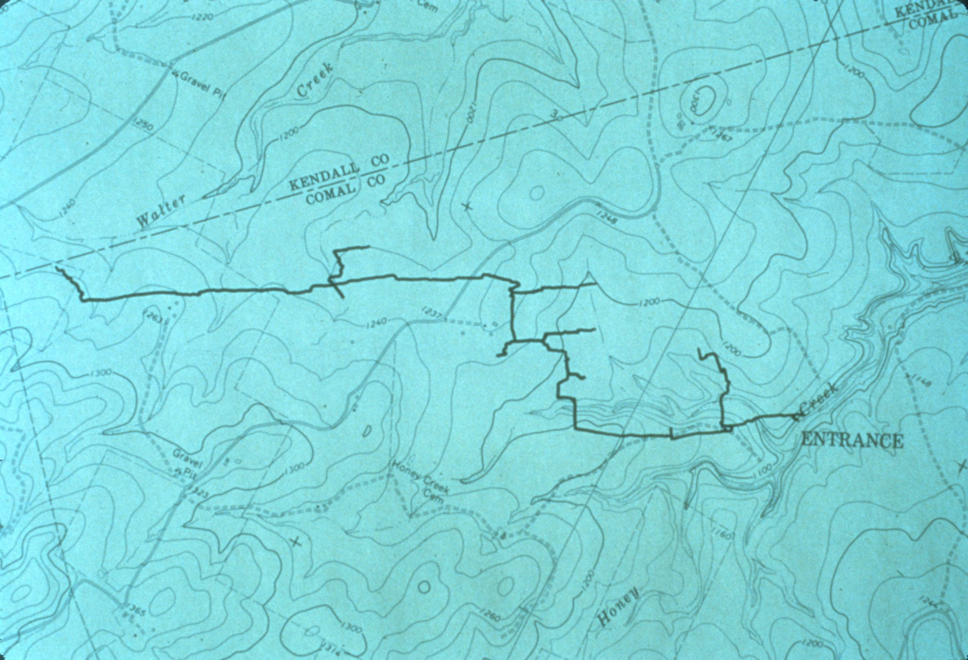
Notes:
This was the extent of Hooey Creek cave in September 1982. For scale, remember that the distance from the entrance to the first side passage, the QA, is about 450 meters. That was also the limit of exploration for many years. At this point in the project, most of the new survey was concentrated along the main stream and only a couple of side passages were looked into.

Slide 43
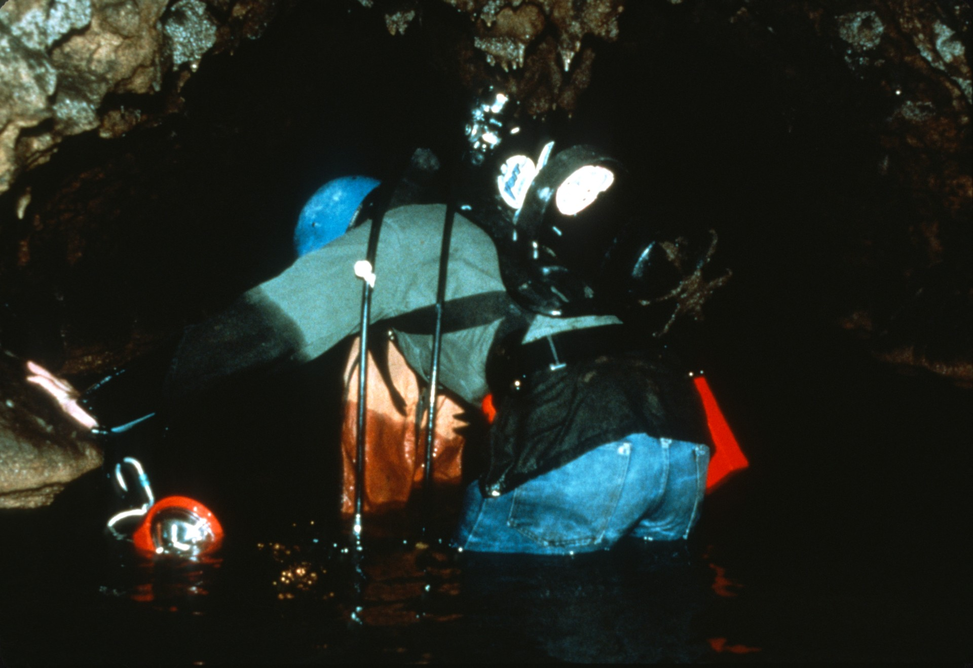
Notes:
But work did proceed in the side passages toward the end of 1982. SCUBA was hauled to the back of the QA and another 314 meters of survey was added. Another 600 meters were added to the cave in the M and R side passages.

Slide 44
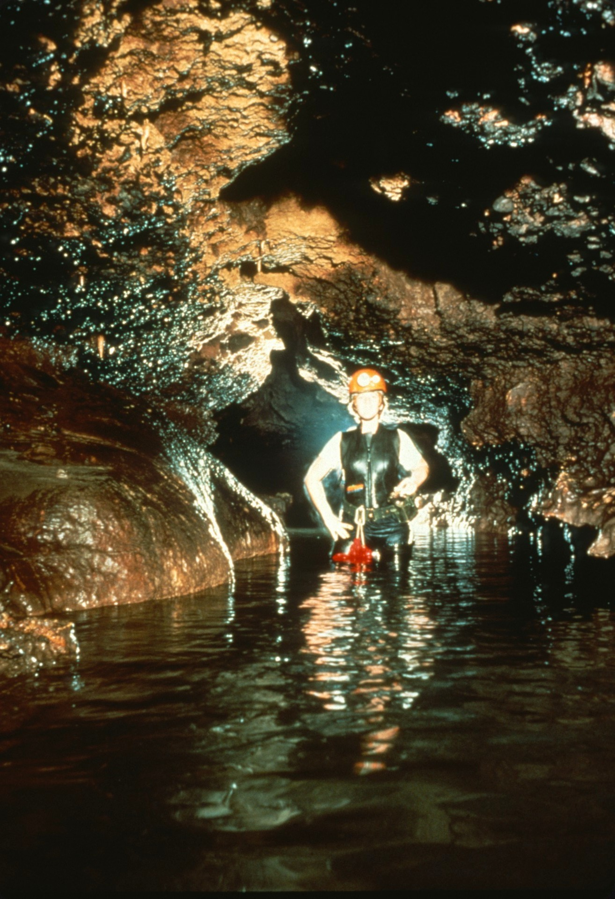
Notes:
The northwest branch of the Bifurcation developed into a major part of the cave. Over a kilometer of cave was mapped and many side passages were found in this passage which became known as "The Boneyard."

Slide 45
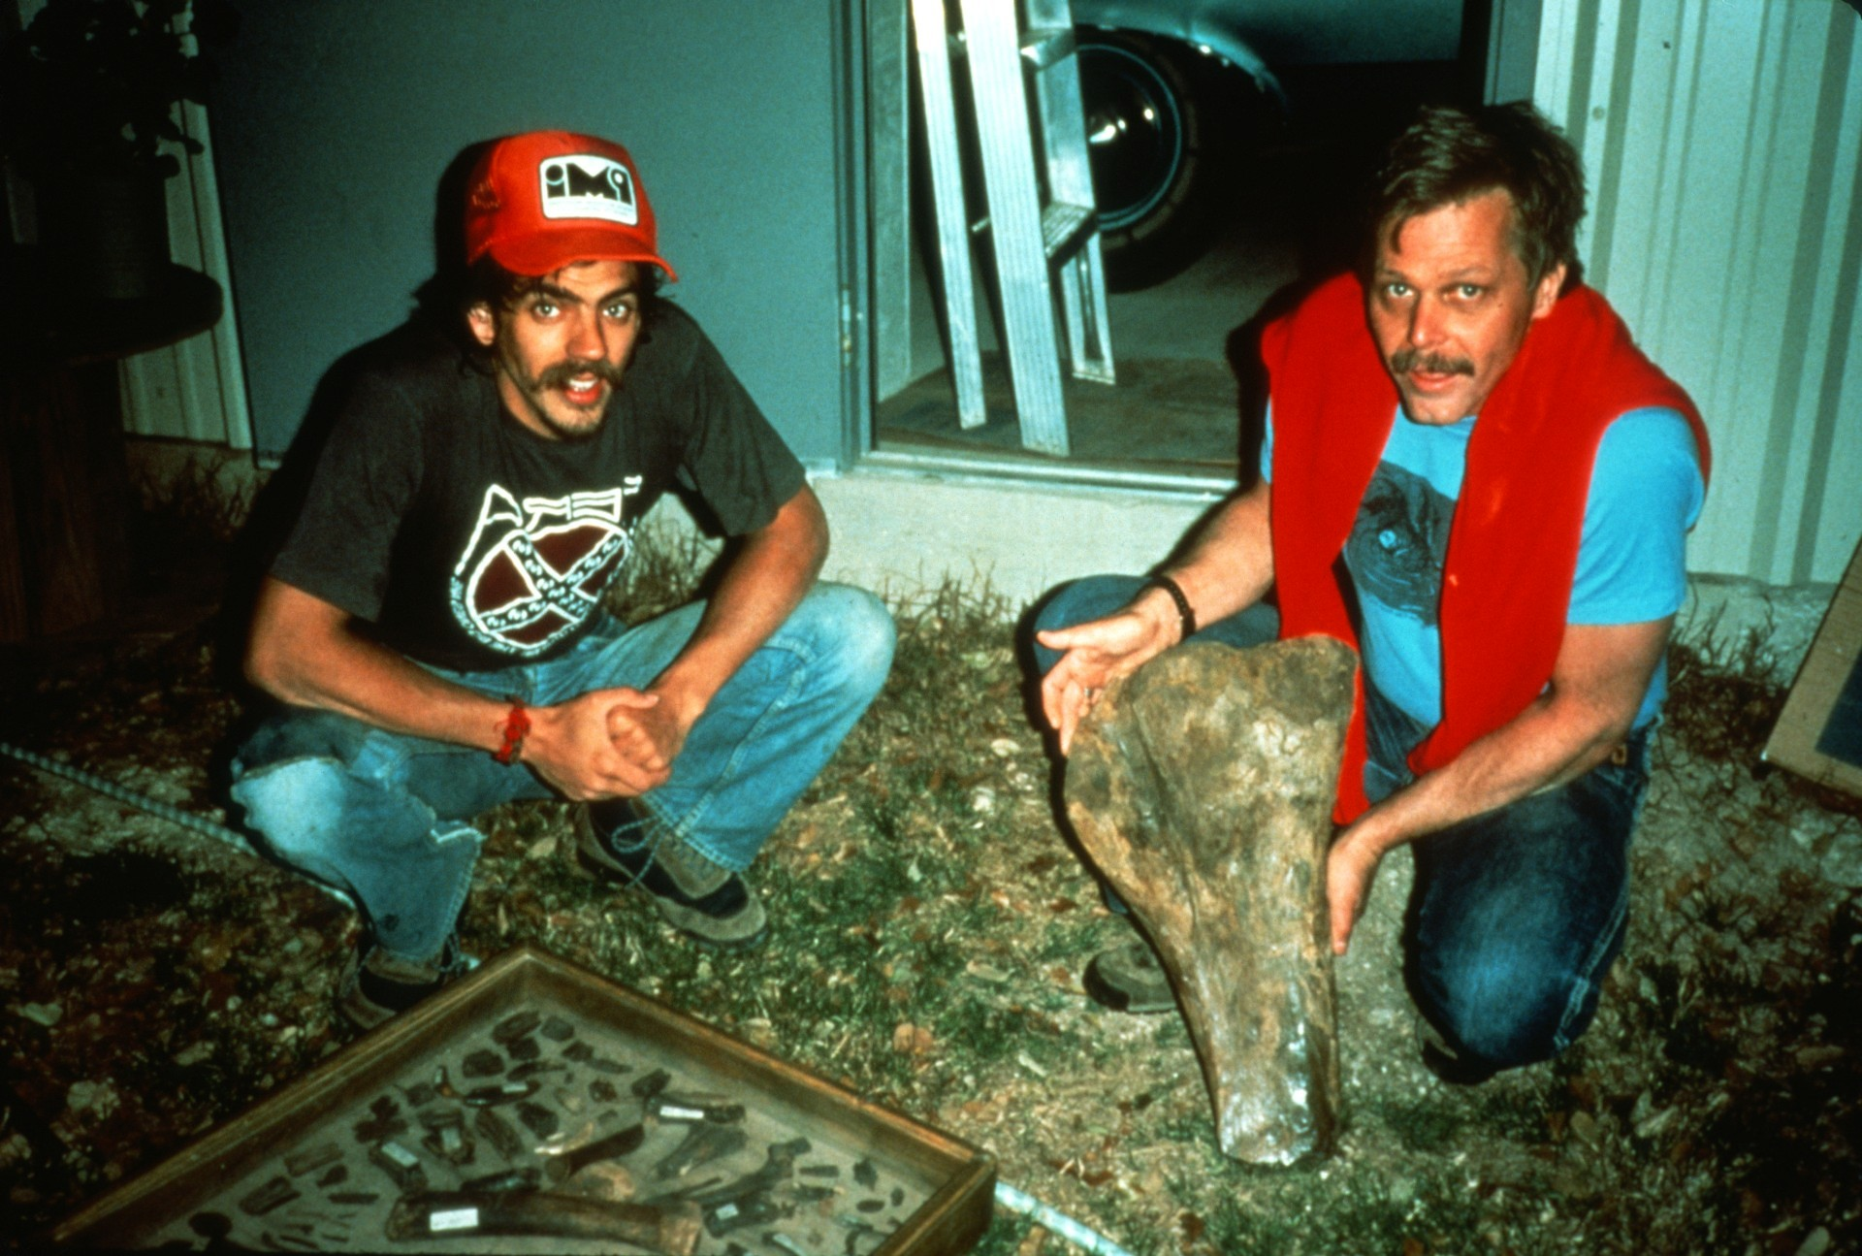
Notes:
The Boneyard and other side passages in Honey Creek Cave were often strewn with bones in the mud and gravel banks. Many were taken out for study at the University of Texas and were dated as from the last Ice Age. The large bone shown here is part of a mastodon femur.

Slide 46
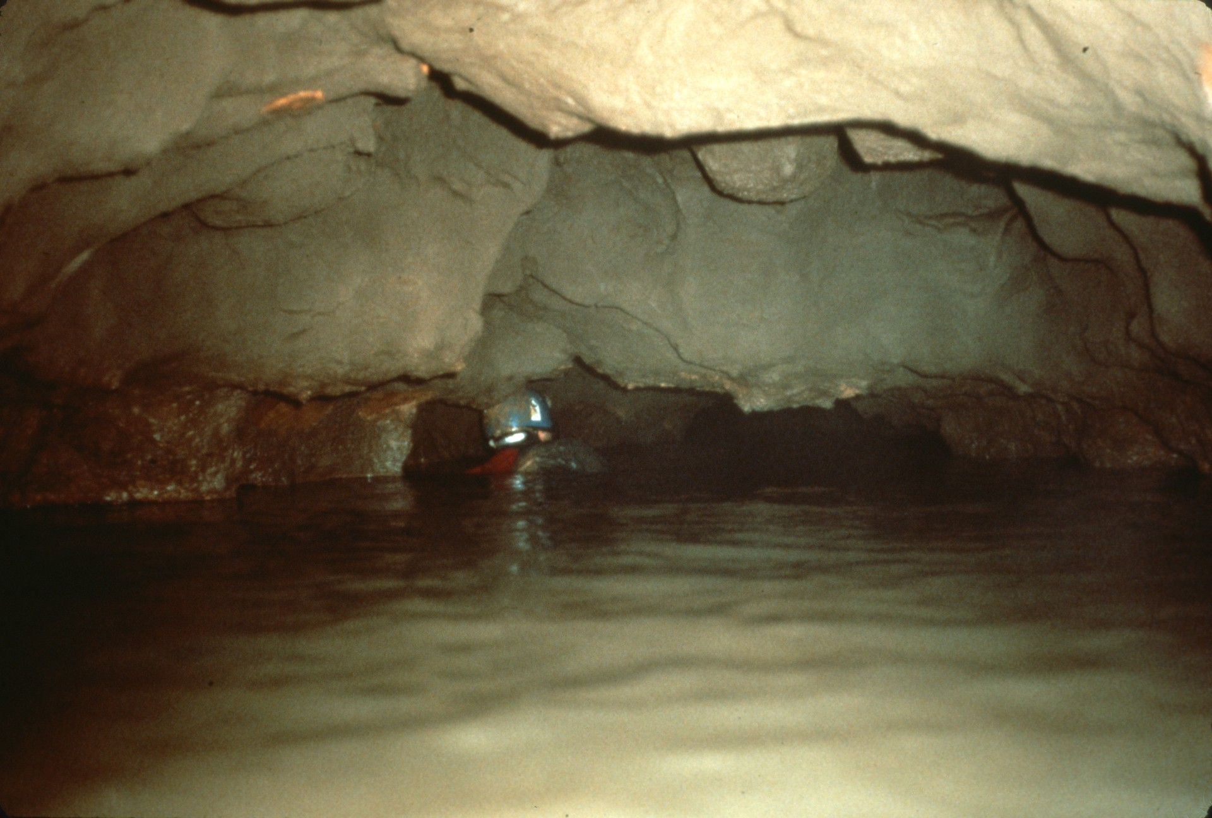
Notes:
At the end of 1982 one last push was made on the far end of the cave. The survey began at the groundwater divide, over 6 hours and 5.4 kilometers of travel from the entrance.

Slide 47
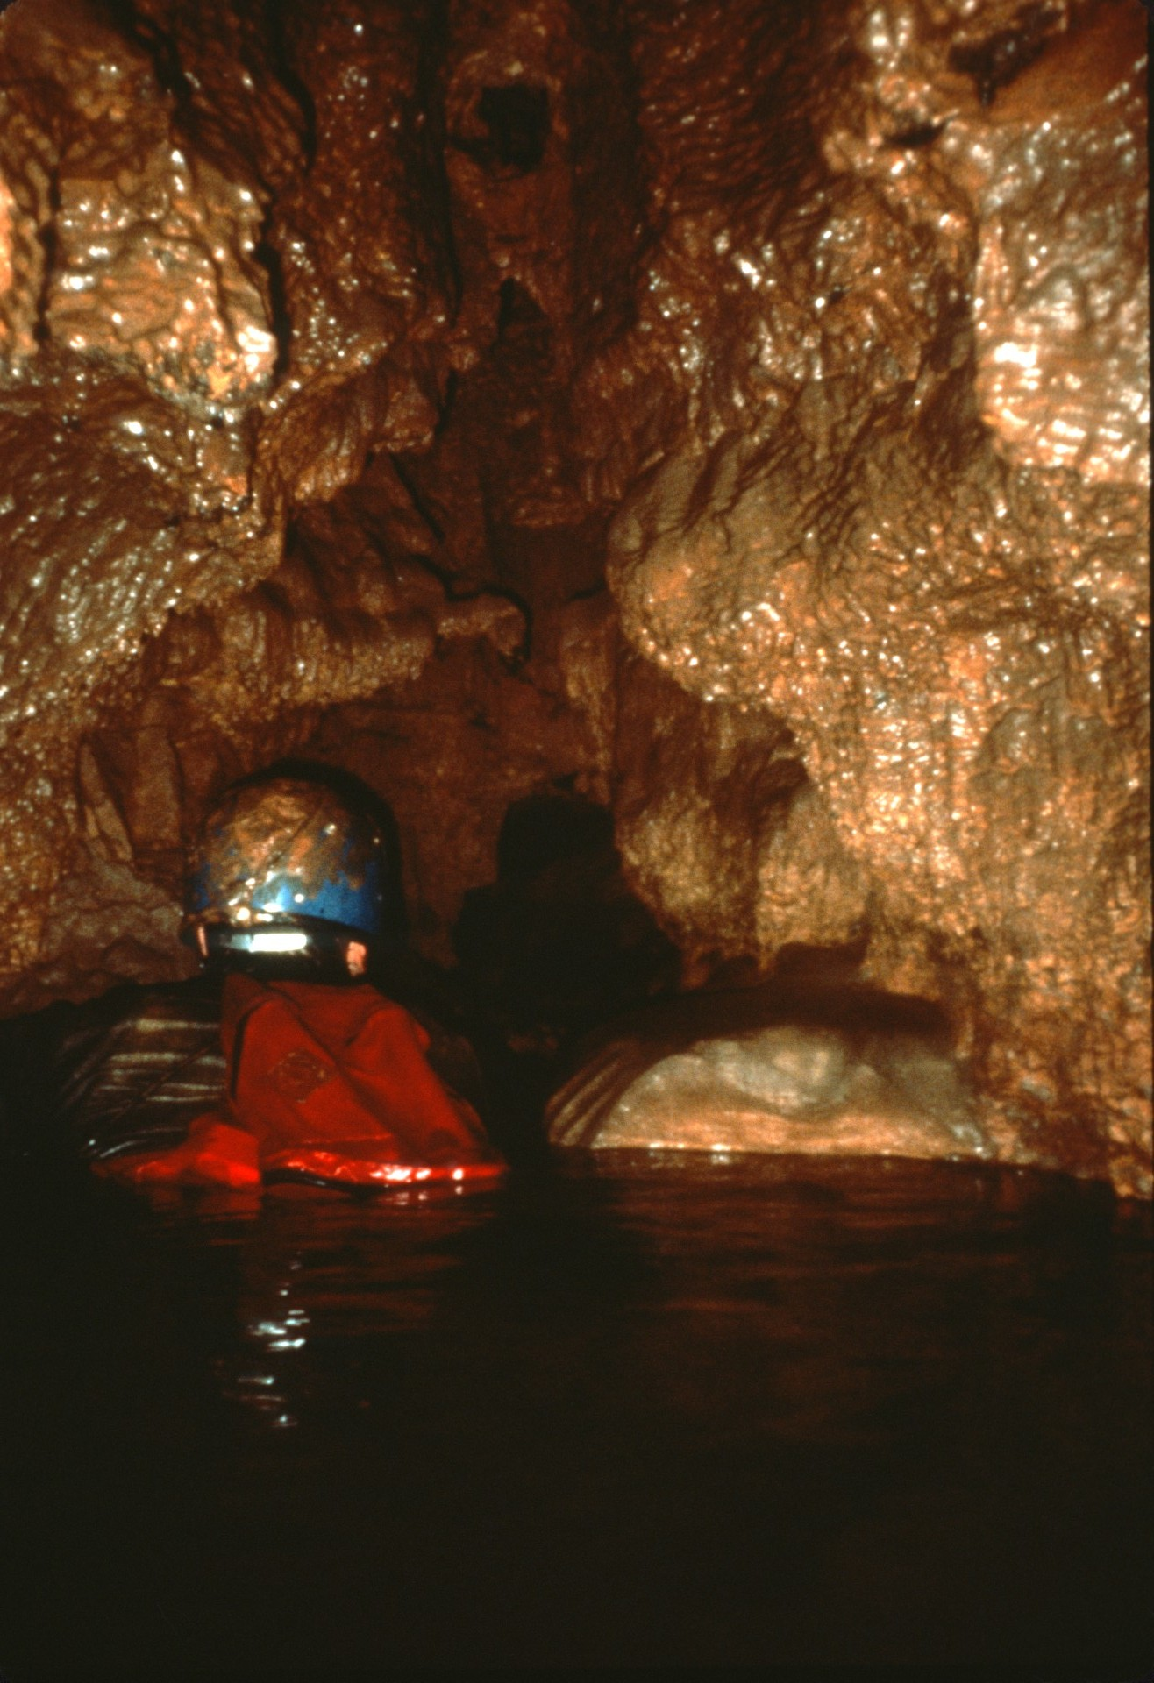
Notes:
As immediately before the divide, the passage was at first small and muddy, but as it picked-up small in-feeders...

Slide 48
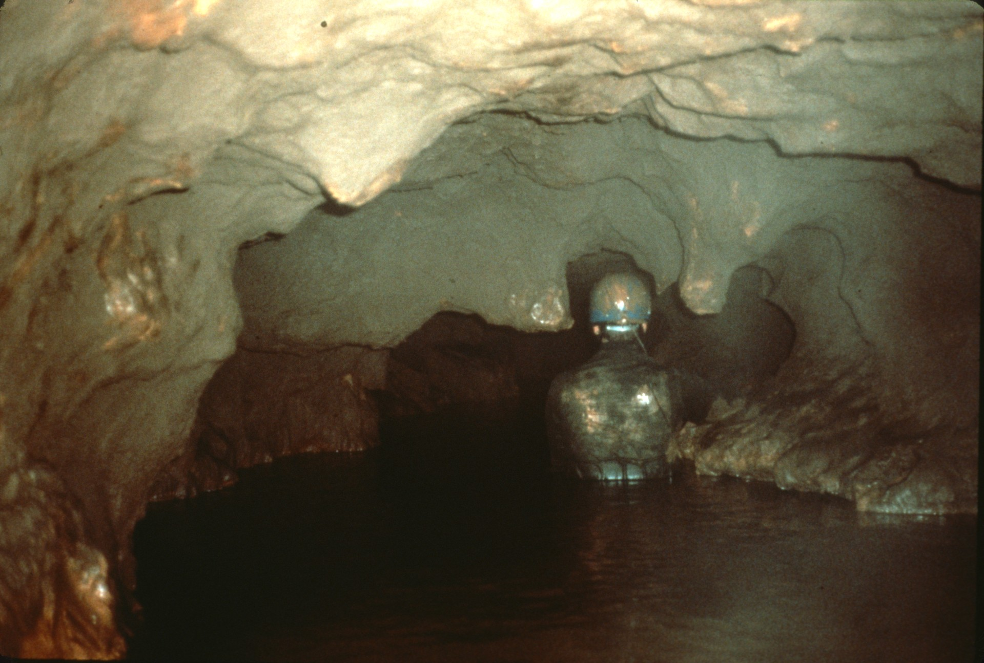
Notes:
…the main passage again began to grow in size. But after 621 meters the physical limits of exploration had been reached.

Slide 49
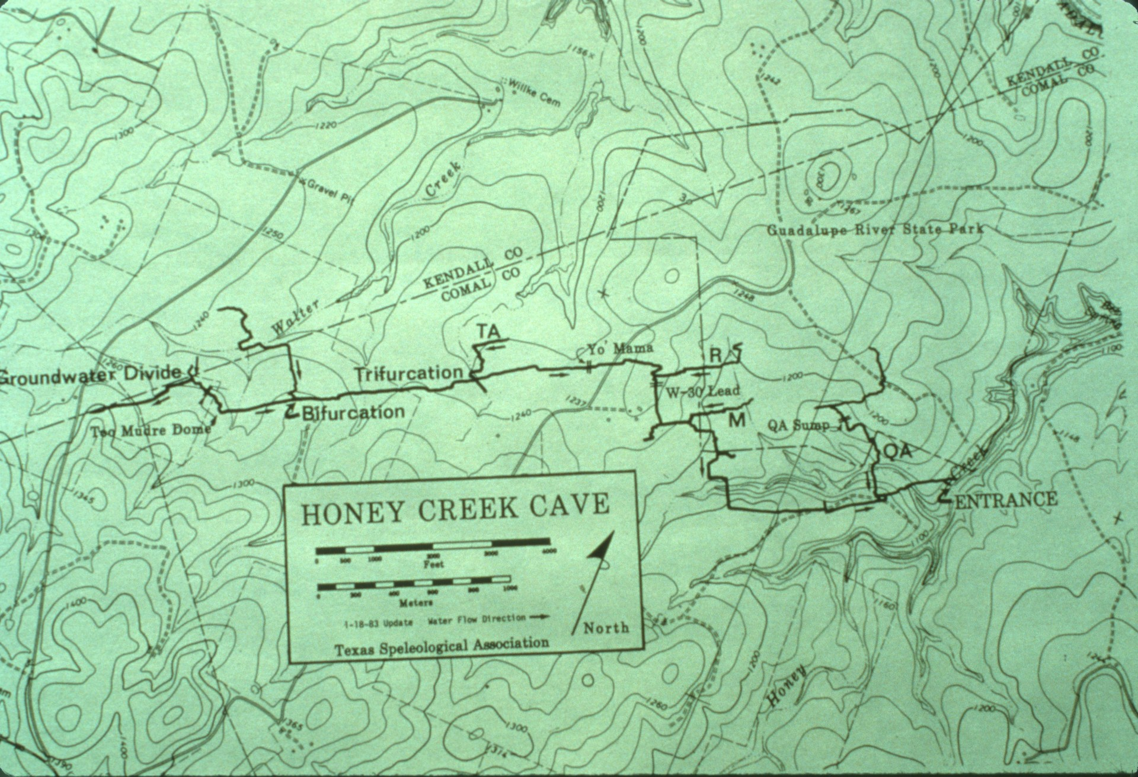
Notes:
This updated map of Honey Creek, from early 1983, shows the end of the survey past the divide and the few side leads which had been checked. The cave was over 9 kilometers long, only half as long as the state’s longest cave, and as yet no end had been reached in any passage. It was clear that a new entrance had to be found if all the leads were to be explored, and if Honey Creek were to challenge the state’s #1 cave.

Slide 50
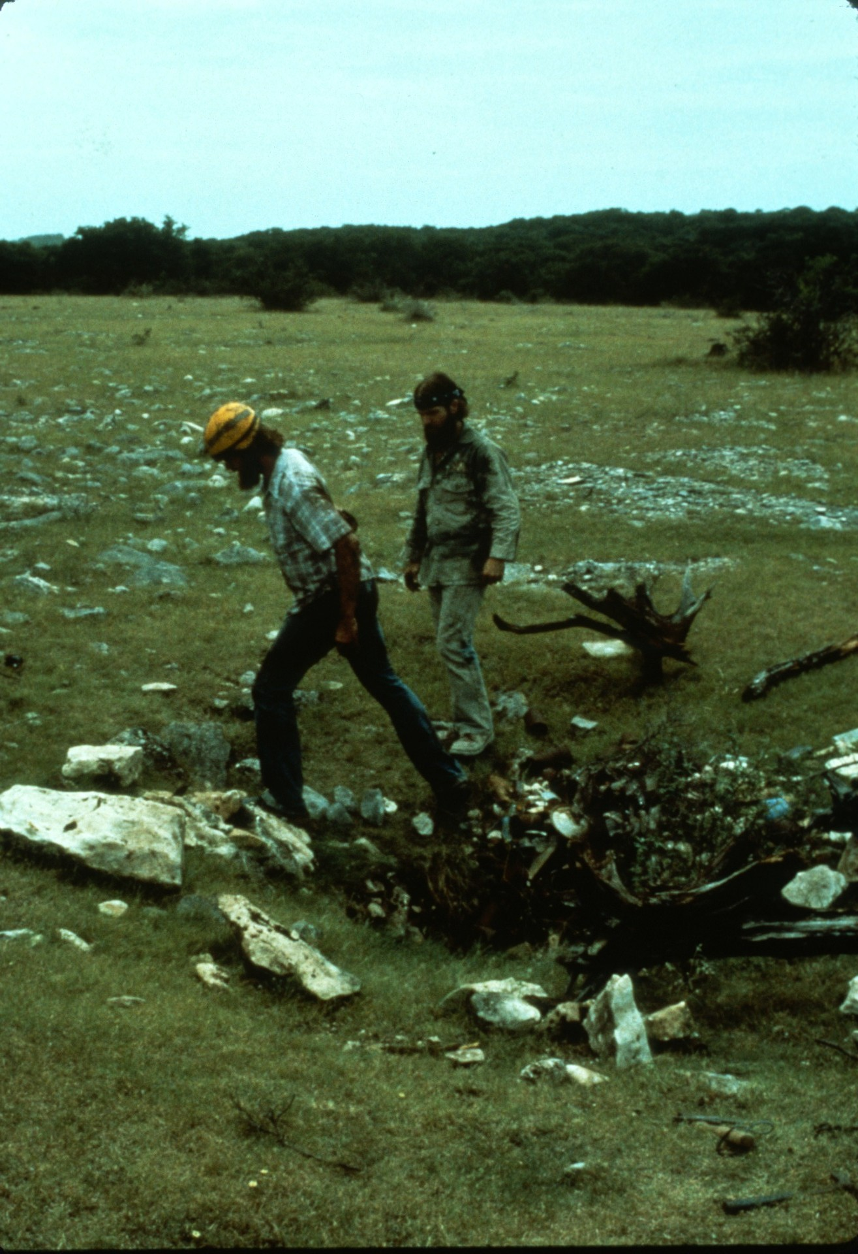
Notes:
That idea of a new entrance was no late revelation; various caves and sinkholes had been looked into since 1981 in hopes of finding a back door to Honey Creek.

Slide 51
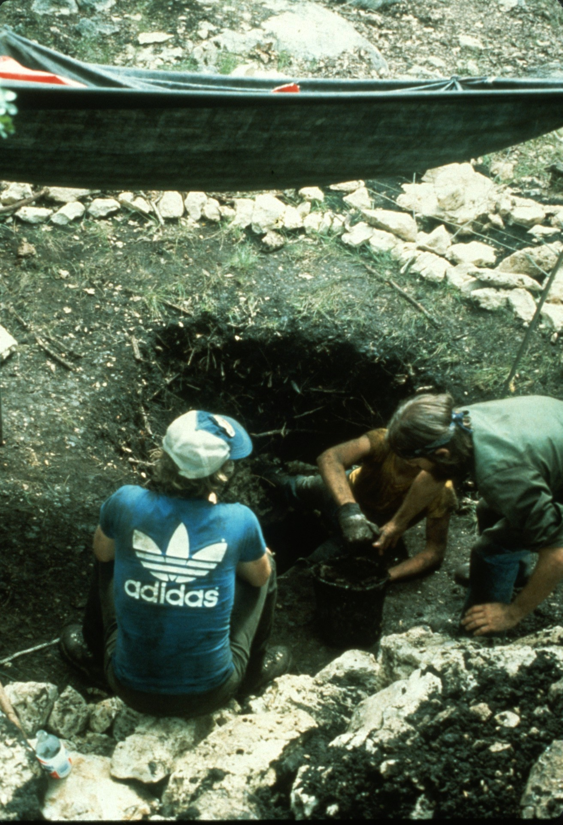
Notes:
Even a few digs were tried but none proved successful.

Slide 52
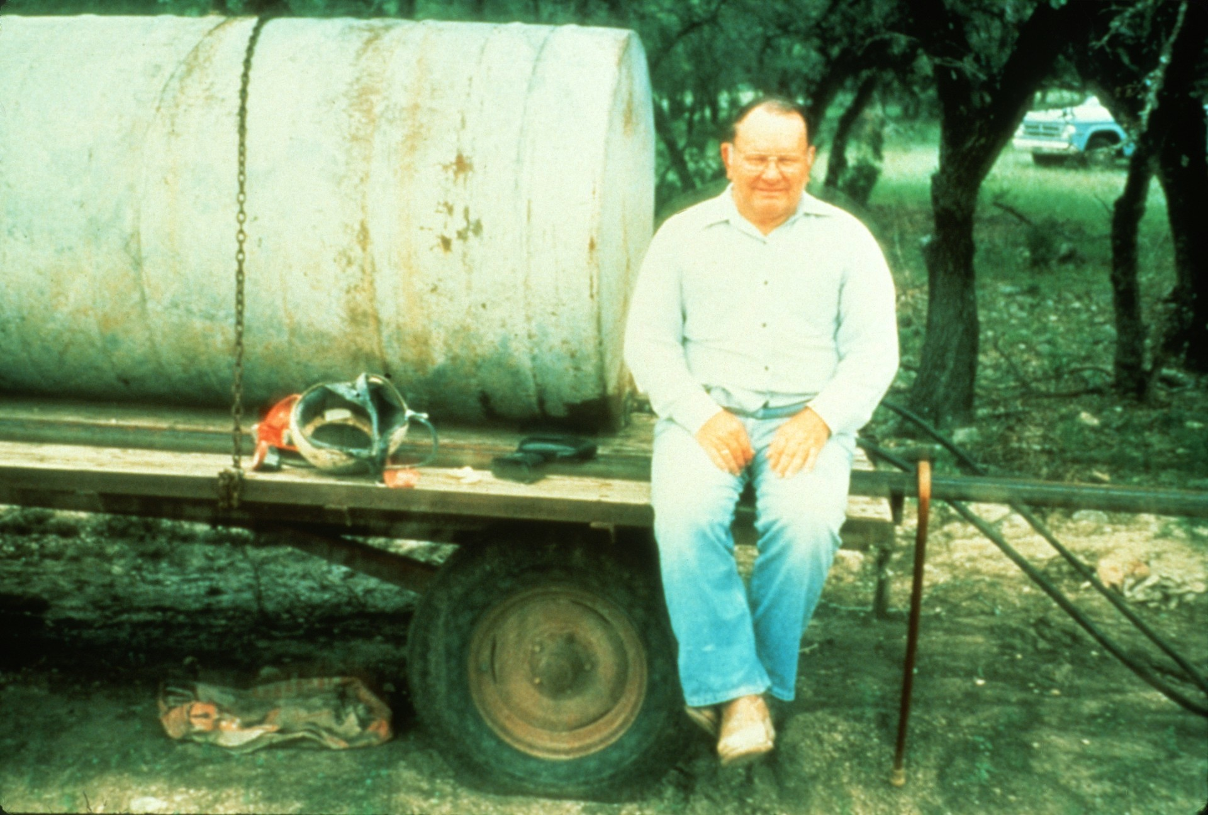
Notes:
It was finally the owner of the cave that solved the problem. It was through his generosity of self and land that the Honey Creek Project could exist in the first place. That generosity was never greater than in 1984 when he said "If you boys show me where you want an entrance, I’ll drill one open for you."

Slide 53
Notes:
Enter Frank Reid with his cave radio. A location was selected as far in the cave as possible, yet still on Mr. Gass's land, and Frank spotted it in short order.

Slide 54
Notes:
True to his word, Mr. Gass brought out a drill and put in a small diameter hole to confirm the location.

Slide 55
Notes:
Cavers swam nearly 4 kilometers upstream to locate the stage for its enlargement to 15 centimeters (6 inches) in diameter.

Slide 56
Notes:
Stage 3 of the drilling came around Christmas with a special-ordered drill bit to ream the hole open to a comfortable 76 centimeters (30.4 inches).

Slide 57
Notes:
Unfortunately the bit was more than the drill rig could handle. After several breakdowns and repairs, drilling was aborted at a depth of only 6 meters. Time for a plan "B“…

Slide 58
Notes:
“BOOM!”

Slide 59
Notes:
The shaft was cased and a tower for hauling was built over it. Cavers were lowered down the shaft carrying a rotary hammer to drill holes. They would then pack the holes with explosives,…

Slide 60
Notes:
…get pulled out of the shaft, and detonate the charge. Blast debris would then be swept down the 15 centimeter (6 inch) drill hole and new charges set. The vertical distance to be excavated, from the surface down to the cave, was 43 meters (142 feet)!

Slide 61
Notes:
When the cave was finally breached in May 1985, the passage was completely filled with blast debris so exploration was still not possible.

Slide 62
Notes:
Large buckets were built and cavers sent down to fill them up with blast rubble. An unexpected source of help in the excavation came from Mother Nature. A large rain flooded the cave with so much water that the rubble was blown out of the way and distributed downstream. Honey Creek now had its new entrance completed, and top spot among Texas caves was now within reach.

Slide 63
Notes:
Establishing new standards and techniques was nothing new to Honey Creek cavers, so this tractor-powered elevator ride into the cave was taken in stride.

Slide 64
Notes:
The new entrance was located at the Trifurcation. From that spot, exploration could be concentrated on the back of the cave, but unexpectedly, exploration was also concentrated up the TA survey, one of the three branches of the Trifurcation.

Slide 65
Notes:
The TA was an interesting lead, but it wouldn't have seen a lot of early effort if the entrance wasn't so close by. The passage carried a fair bit of water and went 640 meters to a travertine dam which completely blocked and sumped the passage. In September 1985, a little chemical persuasion removed the dam...

Slide 66
Notes:
…and trunk passage was found on the far side. The cave's main stream did not go through Yo Mama, on to the Trifurcation and up to the ground water divide, as had been assumed. Instead it continued through an obscure sump, to the trunk rediscovered via the TA passage.

Slide 67
Notes:
The junction of the TA with the trunk was also another water divide for the cave. Water flowed down the TA and also down the trunk to the junction at Yo Mama. With the dam removed, however, all the water was rerouted down the TA. The old water line can be seen on the walls.

Slide 68
Notes:
Downstream in the trunk, the passage went about 400 meters to a large and well-decorated room called "The Grande Finale." This room sumped about 50 meters short of connecting to the Yo Mama junction, but the connection was made latter with SCUBA.

Slide 69
Notes:
Upstream in the new trunk passage, the TB Survey, the passage jumped 2.5 meters higher...

Slide 70
Notes:
…then continued wide and wonderful as before. On first survey into this area, Mark Minton (who was leading the push up the TA) led a team which surveyed an amazing 1.2 kilometers in one trip!

Slide 71
Notes:
Eventually the TB sumped, but notching of downstream dams yielded more than 3 kilometers of new cave, which is pushing cavers’ endurance limits. The cave goes big, but it’s a hard 7-hour trip to get there.

Slide 72
Notes:
The cave’s new shaft entrance put the water divide area within reach. In July 1985 the divide’s PS or downstream survey was mapped 323 meters to a major junction.

Slide 73
Notes:
A large volume of high-velocity water flowed out of one passage and, joining flow with the OS water, rushed down this crawl. The crawl was surveyed for 160 meters and progressively became smaller. Exploration was aborted when the high water flow threatened to sump the passage behind the cavers as their bodies dammed the stream.

Slide 74
Notes:
Upstream of the junction the fast water was followed up the HS, or "Holy Shit," passage for 910 meters to a sump.

Slide 75
Notes:
The third major extension to Honey Creek Cave made up the Boneyard. The end of the Boneyard had been pinching down but it soon hit a water divide, the passage grew larger again and was mapped for 1,910 meters -- and past two more water divides.

Slide 76
Notes:
The far end of the Boneyard ended in a deep sump. A nearby passage connected to the HS flow, bypassing its sump but soon finding another sump further upstream. Some believe the HS and Boneyard sumps are related to each other, and carry water pirated underground from Cibolo Creek more than 6 kilometers away.

Slide 77
Notes:
While spectacular finds were being made at the cave’s outer limits, significant work was also accomplished in surveying over 2.5 kilometers in many of the cave’s smaller side passages. Within 16 months of opening the shaft entrance, 10.7 kilometers of cave was surveyed to make Honey Creek the longest cave in Texas.

Slide 78
Notes:
With a cave like Honey Creek it's hard to publish map that’s up-to-date. Regular monthly trips keep outdating it. As of February 1989 the cave was 28.4 kilometers (18 miles) long.

Slide 79
Notes:
It’s often said that "all good things must come to an end," but in Honey Creek it’s not at all certain where the end lies. Almost 180 leads remain unchecked. The best leads promise many more kilometers of exploration and survey, but also challenge the limits of caver skill and endurance. Whatever the project’s fate, there is always hope - - another water divide may be found around the next muddy corner to lead downstream into larger passage and salvation. And where hope is not redeemed there is still pride -- by the cave’s owner and the many cavers who have pushed long and hard under his land in one of the longest caves of the world, unique for its world- class swims and distances of travel -- pride in having contributed to the exploration of Honey Creek, the water cave.

Slide 80
Notes:
The Honey Creek Project is the summed effort of more than 80 cavers throughout Texas. Their deepest and continuing appreciation is extended to the cave's owner, Mr. J. J. Gass for his assistance and generosity . Anyone interested in visiting the cave please Do Not Contact The Owner but contact project members for more information.

Slide 81
Notes:
The program was developed and written by George Veni using slides from Jim Bowden, Bob Cowell, Keith Goggin, Kurt Menking, Steve Robertson, Peter Sprouse, George Veni, and Randy M. Walers.

Slide 82
An NSS Audio-Visual Library Presentation
A Wet Dream: Exploration of Honey Creek Cave, 1989
Original slide program S742
Slides digitized by David Caudle
Script transcribed by Alex Sproul
PowerPoint program created by Jim McConkey
82 slides, with script in presenter notes
PowerPoint created 2/11/2021
National Speleological Society
6001 Pulaski Pike
Huntsville, AL 35810-1122
256- 852-1300
nss@caves.org
https://caves.org/

